Slide 1

Sandra Burke
May 14, 2015

Slide 2



Iowa & U.S. trends
How population changes
Youth trends
Race and ethnicity trends
Language trends

Slide 4
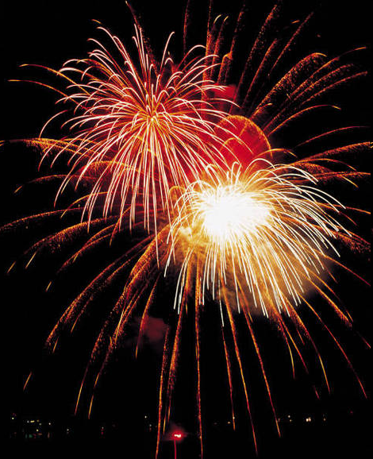
!!!3 Million!!!
!!!3 Million!!!
!!!3 Million!!!
!!!3 Million!!!

Slide 5


Slide 7


Slide 8


Slide 9


Slide 11
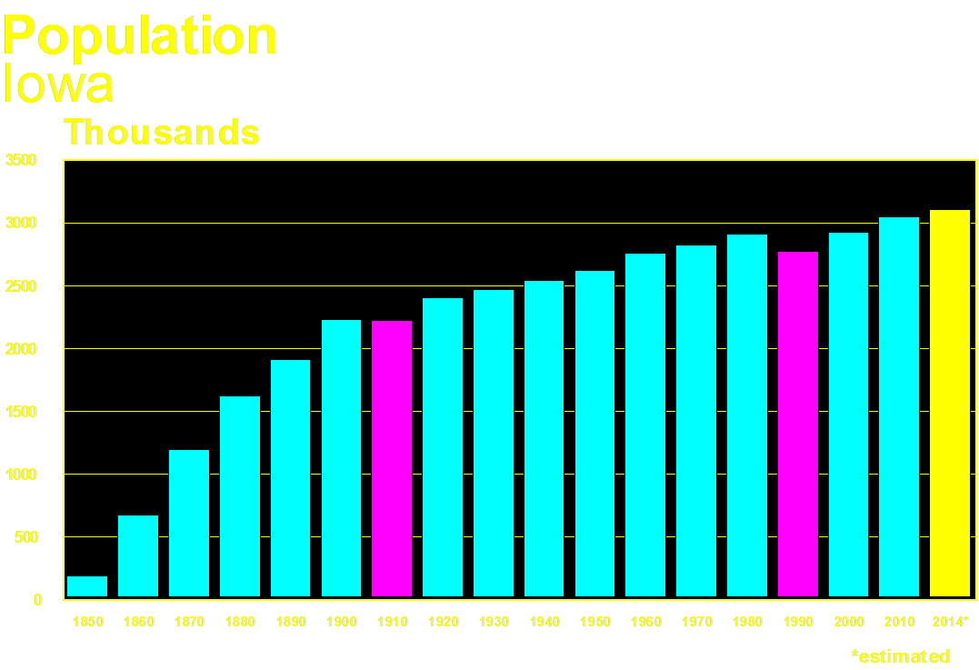

Slide 13


Slide 15


Slide 16
Iowa is growing,
but very slowly.

Slide 17
Most other regions of the U.S. are growing faster.

Slide 18
Many areas of Iowa
are not growing
but are decreasing in population.

Slide 19

Components of Change

Slide 20
Components of Change
Births
Deaths

Slide 21
Components of Change
Births
Move In
Deaths
Move Out

Slide 23
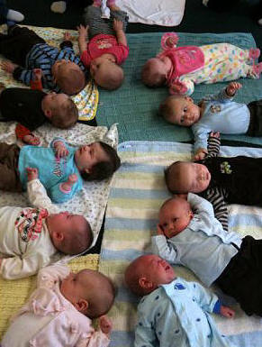
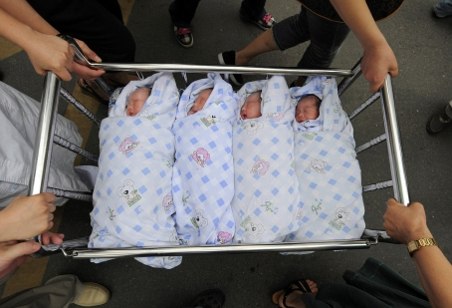
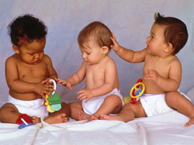
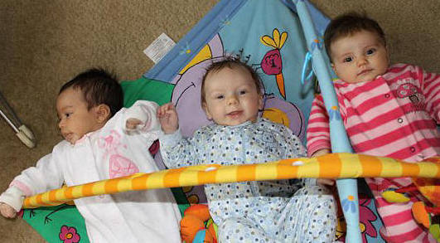


Slide 24
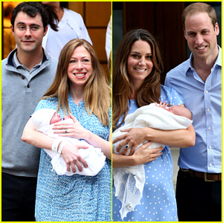
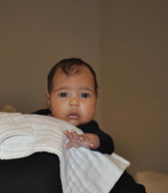
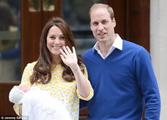
Charlotte
North
George
Charlotte

Slide 25
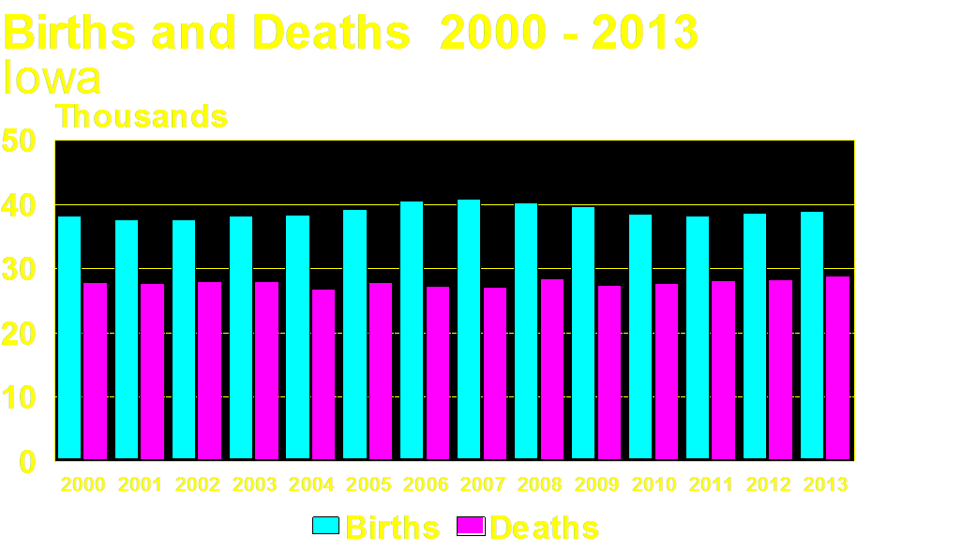

Slide 26
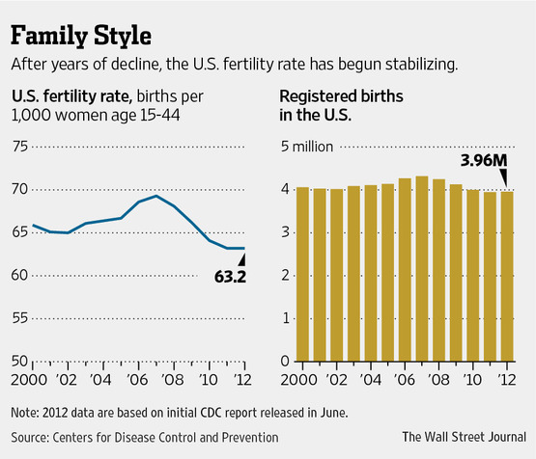
NY Times Aug. 9, 2009
Wall Street Journal Sept. 5, 2013

Slide 27
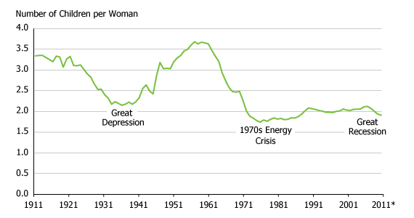
Population Reference Bureau: www.prb.org, Sept. 6, 2013

Slide 28
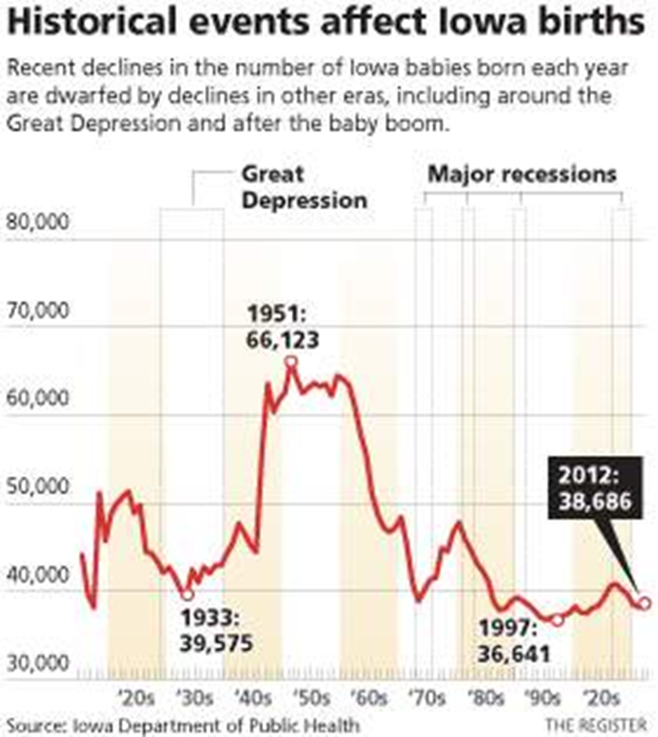

Slide 30
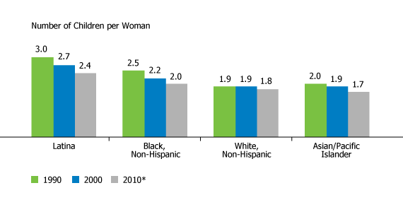

Slide 31
Birth rates 2013
Total 12.6
White 11.6
Black 21.6
Asian/Pacific Is 20.2
Hispanic 19.8

Slide 32
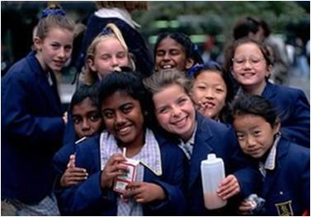
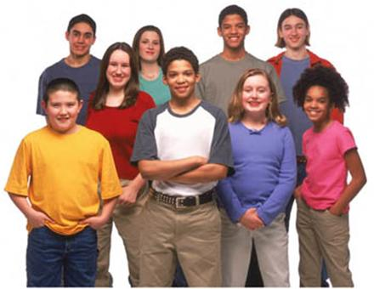

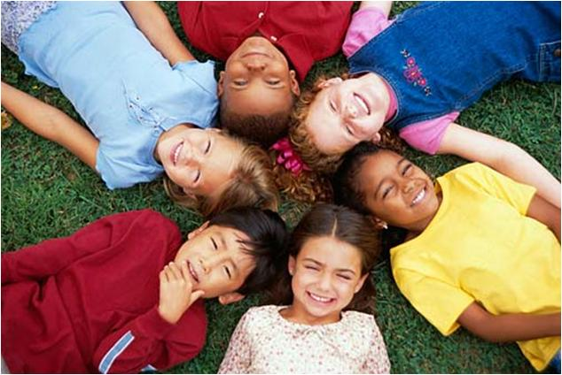

Slide 33
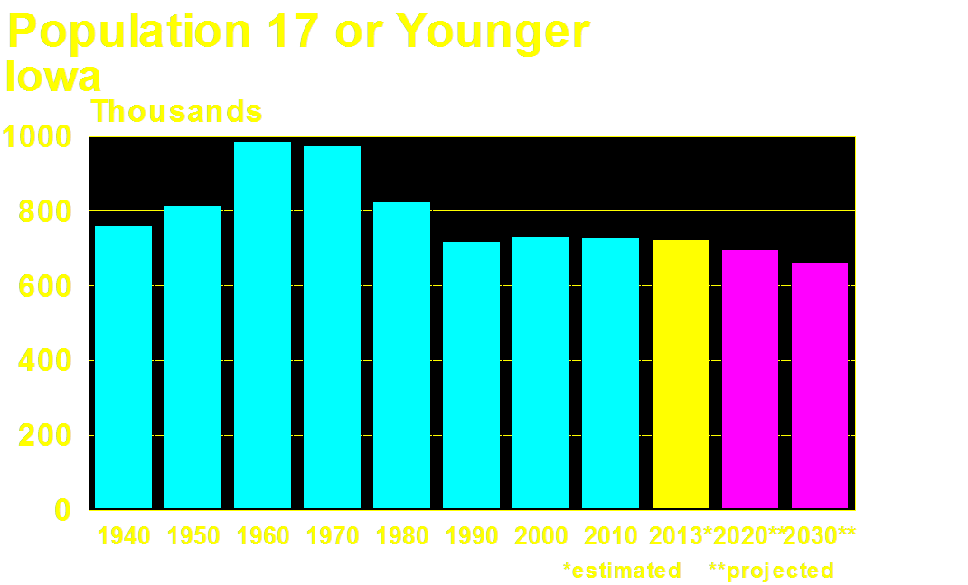

Slide 37
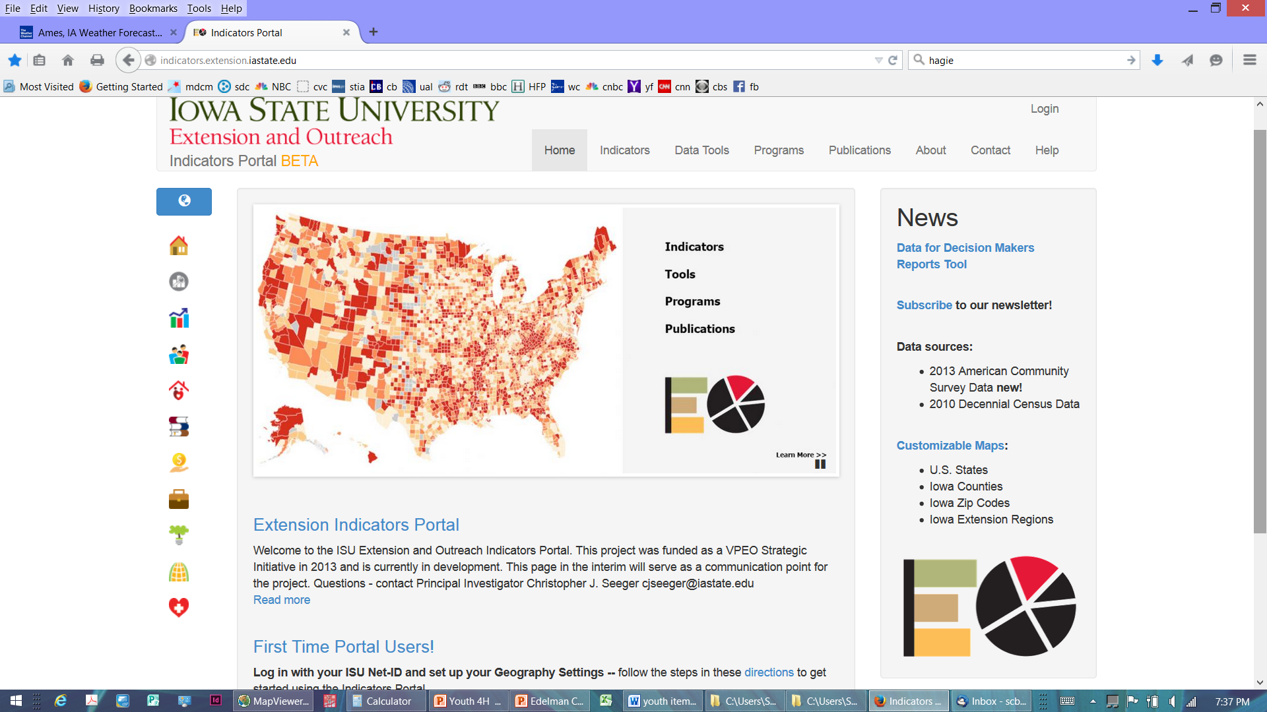
indicators.extension.iastate.edu

Slide 38
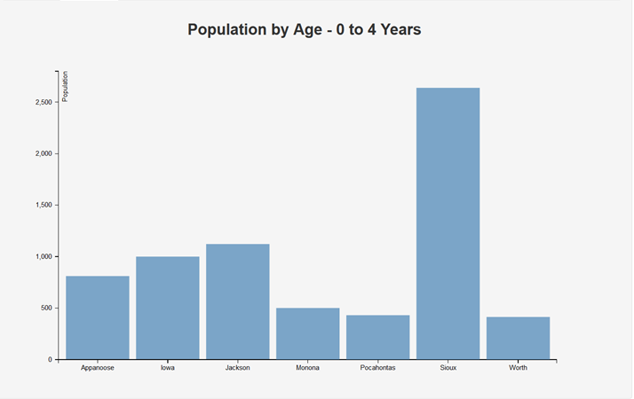

Slide 39
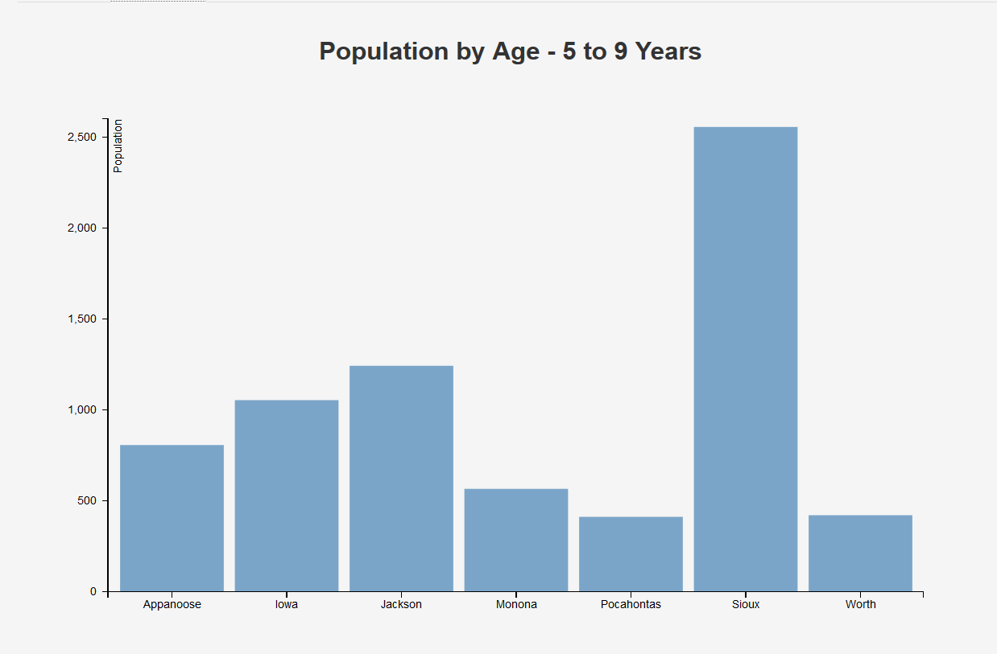

Slide 40
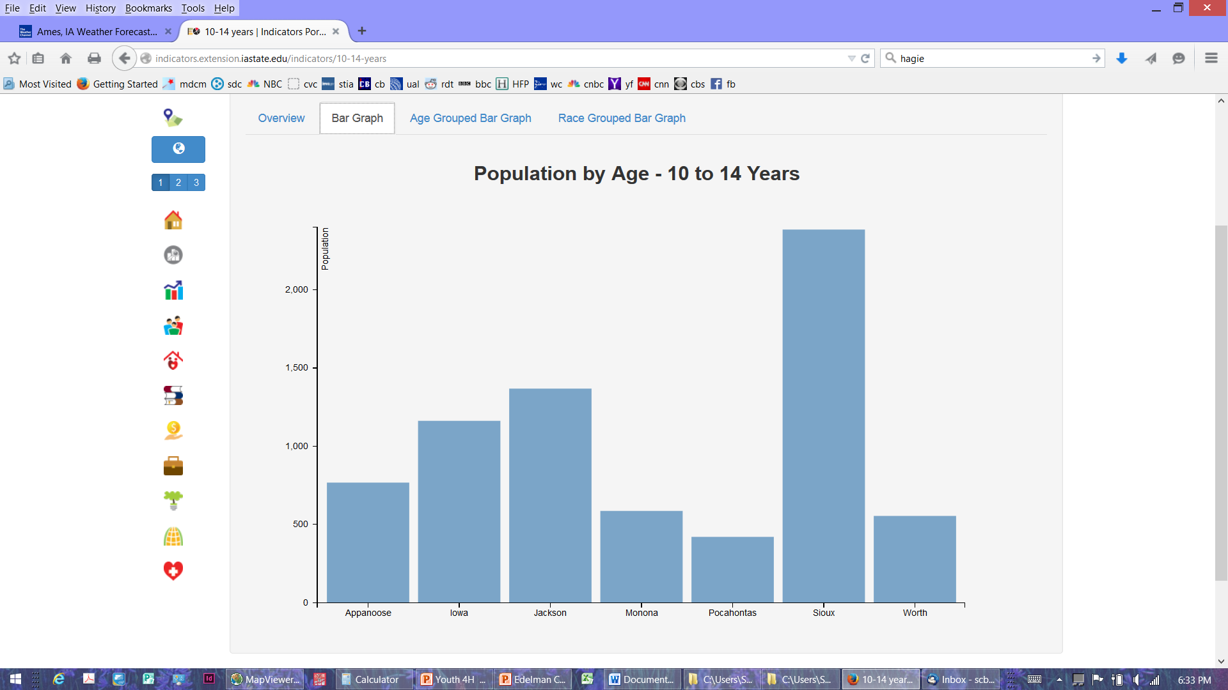

Slide 41
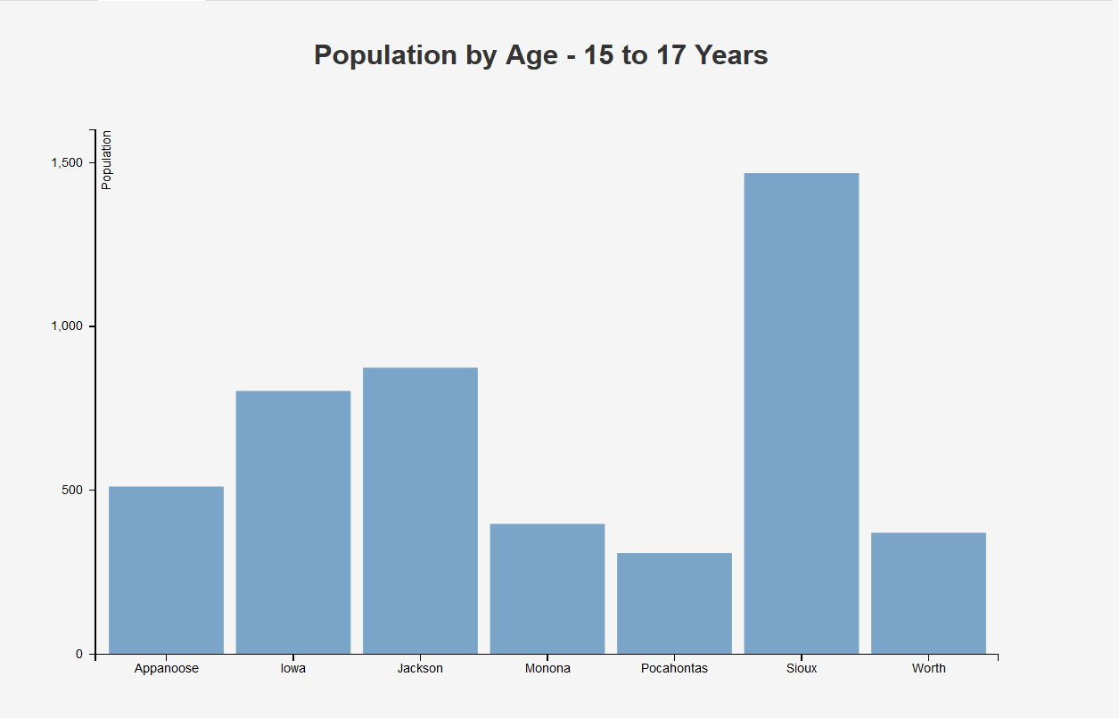

Slide 42
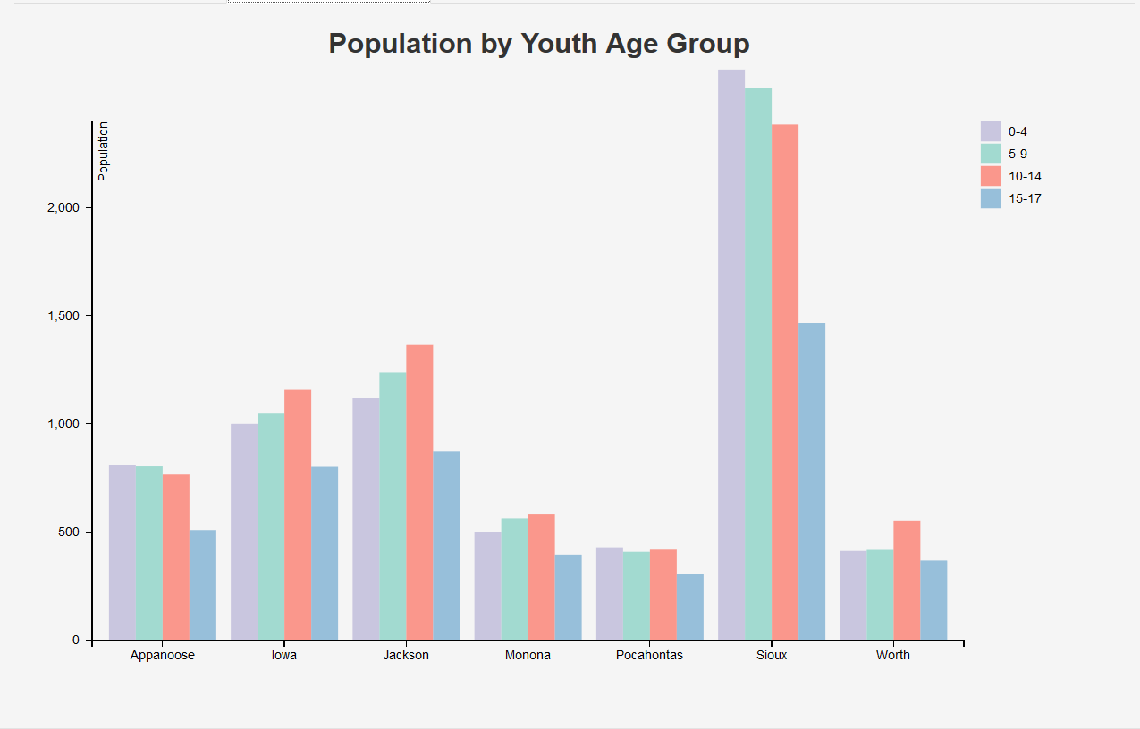

Slide 43
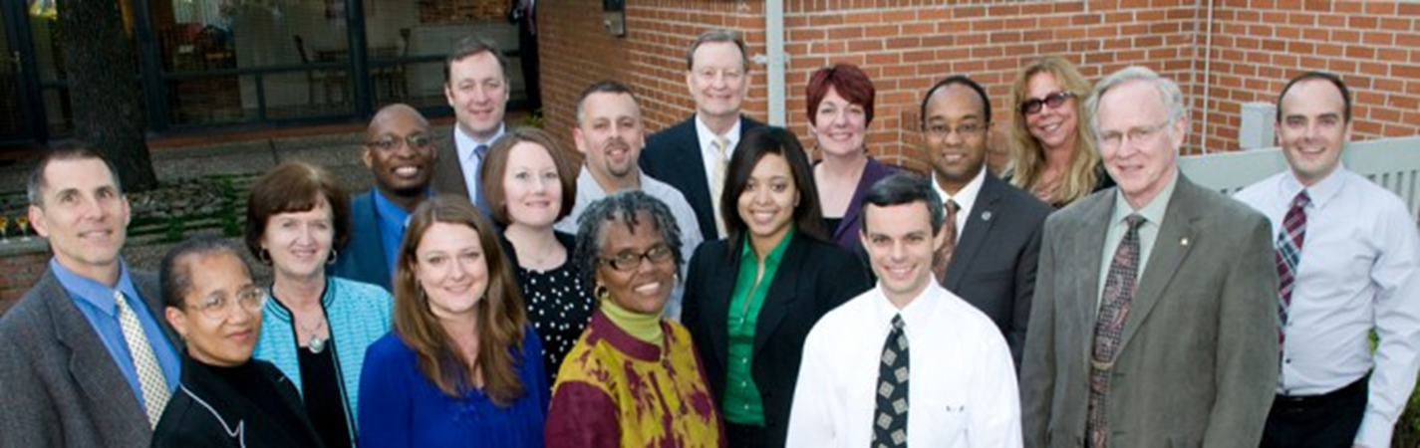
Race and Ethnicity

Slide 44


Slide 45
Race Groups Census 2010
United States
Percent
One Race: 97.1
White 72.4
Black or African American 12.6
American Indian, Alaska Native 0.9
Asian 4.8
Native Hawaiian, Pacific Islander 0.2
Some Other Race 6.2
Two or More Races 2.9
----------
Hispanic Origin (any race) 16.3

Slide 46
Race Groups Census 2010
Iowa
Percent
One Race: 98.2
White 91.3
Black or African American 2.9
American Indian, Alaska Native 0.4
Asian 1.7
Native Hawaiian, Pacific Islander 0.1
Some Other Race 1.8
Two or More Races 1.8
----------
Hispanic Origin (any race) 5.0

Slide 47
Hispanics & Race Census 2010
United States Iowa
White 54.3% 55.2%
Some Other Race 38.5 35.42
Black, Native American,
Asian, Pacific Islander 7.2 6.6

Slide 48
Race Groups Census 2010
United States Iowa
White Alone, Not Hispanic
2000 69.1% 92.6%
2010 63.7 88.7
Minority (all others)
2000 30.9 7.4
2010 36.3 11.3

Slide 50
Percent Minority Iowa
2013* 12.4%
2010 11.3%
2000 7.4%
1990 4.1%
1980 3.1%
*estimated

Slide 51
Minorities in Iowa
2013* 383,726
2010 345,232
2000 215,980
1990 112,915
*estimated

Slide 52
White Alone, not Hispanic
2013* 2,706,690
2010 2,701,123
2000 2,710,344
*estimated

Slide 56
Whites in Iowa
2013* 2,857,316#
2010 2,781,561#
2000 2,748,640#
1990 2,683,090
# one race only
*estimated

Slide 57
Blacks in Iowa
2013* 101,368#
2010 89,148#
2000 61,853#
1990 48,090
# one race only
*estimated

Slide 58
Am Indians in Iowa
2013* 14,742#
2010 11,084#
2000 8,989#
1990 7,349
# one race only
*estimated

Slide 59
Asians in Iowa
2013* 63,291#
2010 53,094#
2000 36,635#
1990 25,476**
# one race only **combined Asian, Hawaiian
*estimated

Slide 60
Hawaiian/Pacific Island
2013* 2,753#
2010 2,003#
2000 1,009#
# one race only
*estimated

Slide 61
Two or More Races
2013* 50,945
2010 53,333
2000 31,778
*estimated

Slide 62
Hispanics# in Iowa
2013* 168,806
2010 151,544
2000 82,473
1990 32,647
# any race
*estimated

Slide 66
Percent Minority Iowa
2010* 11.3% total
2010** 18.0% school
2013* 12.4% total
2013** 21.2% school
*total population
**school enrollment

Slide 67
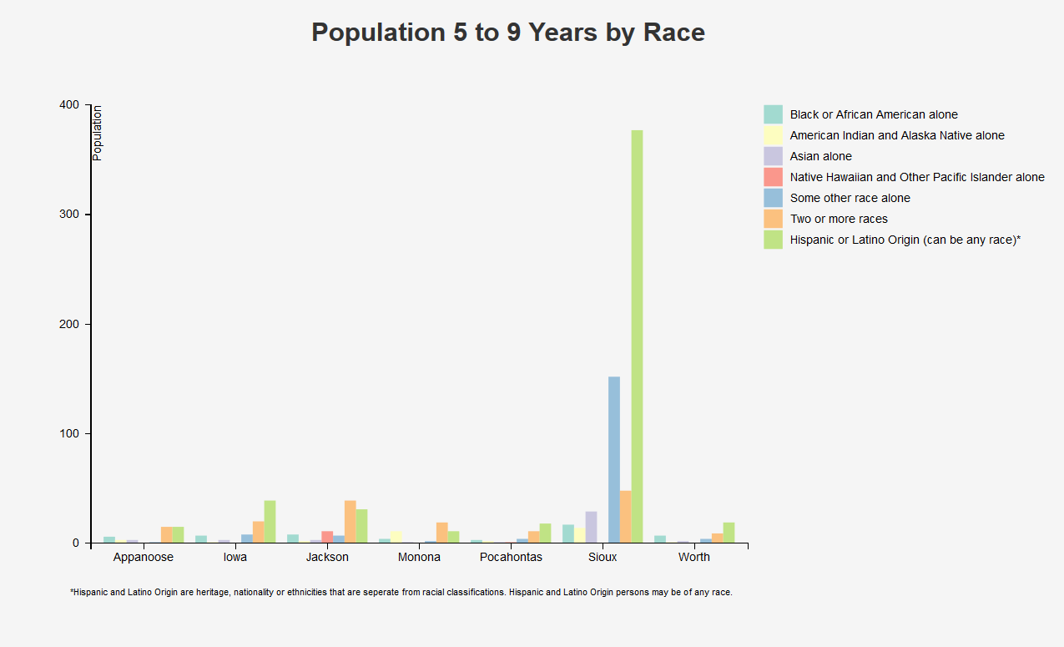

Slide 68
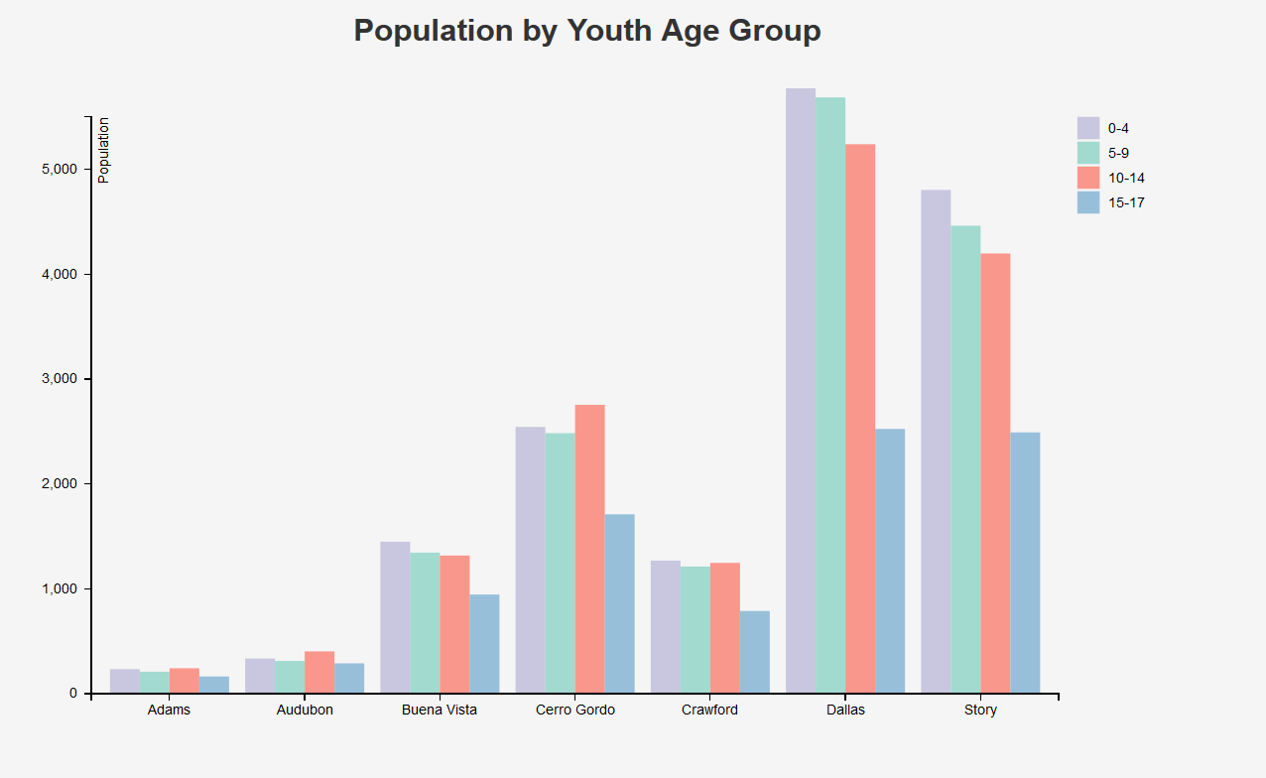

Slide 69
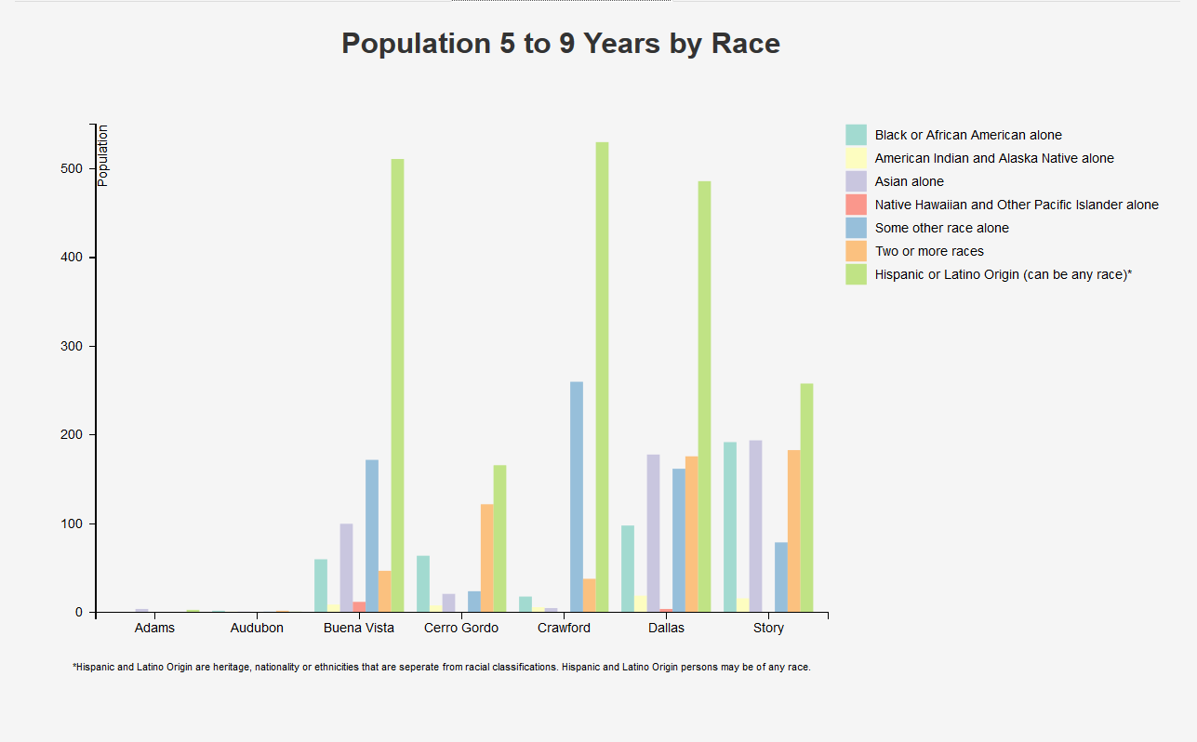

Slide 70
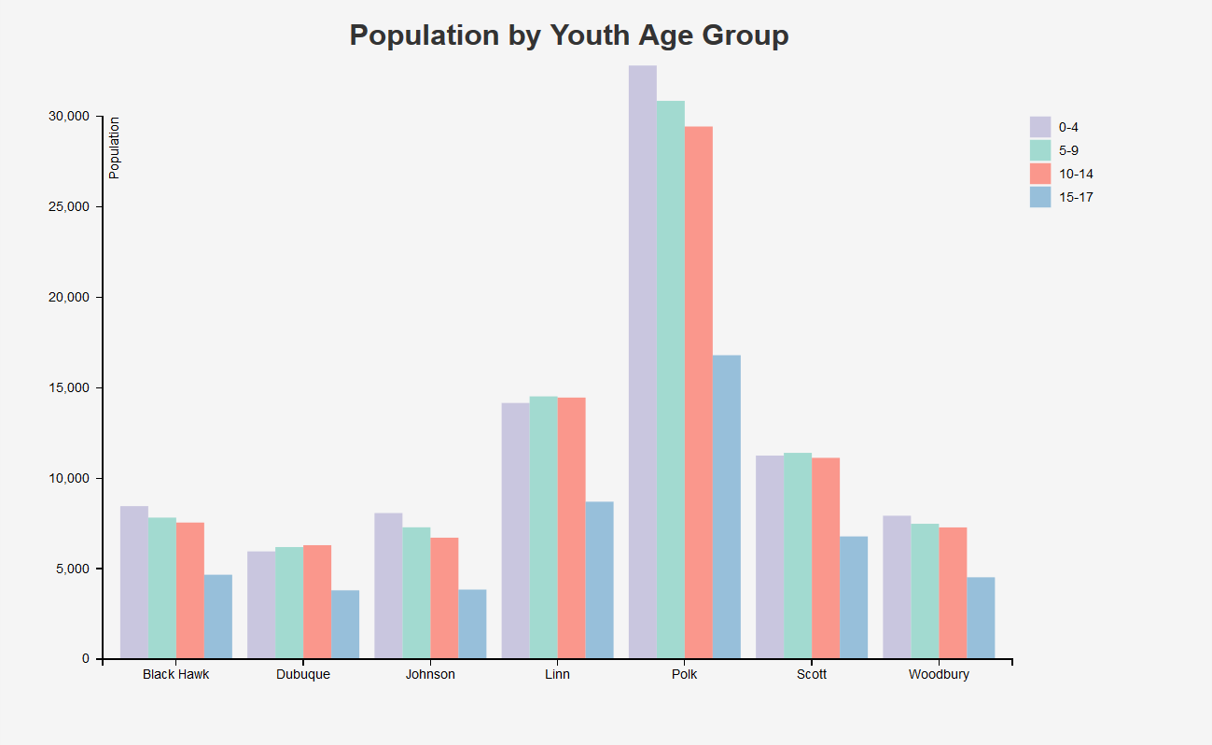

Slide 71
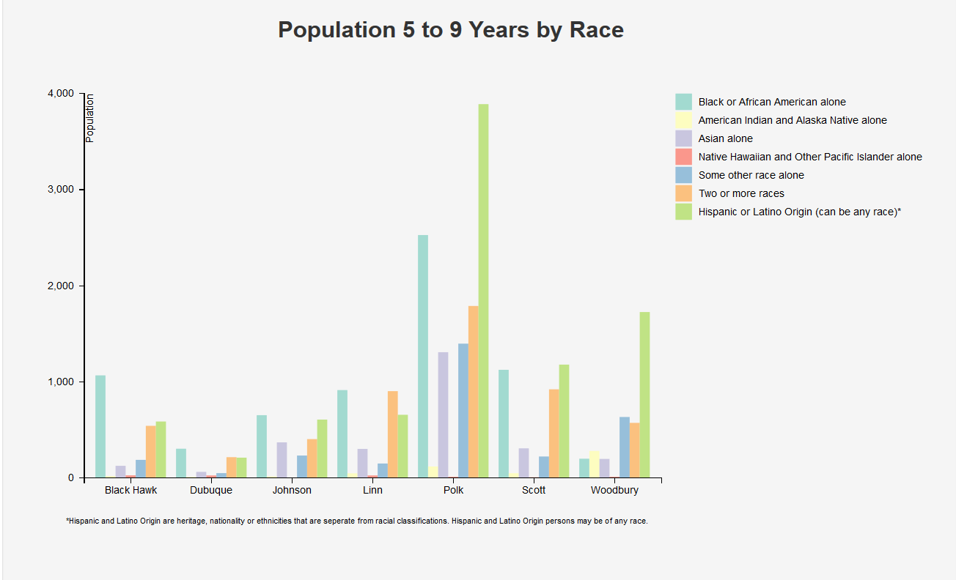

Slide 72
Minorities in Iowa have increased significantly.

Slide 73
Hispanics are the largest minority group in Iowa.

Slide 74
Iowa remains much less diverse than many other areas of the U.S.

Slide 75
Some areas of Iowa still have relatively few minority persons.

Slide 76
Components of Change
Births
Move In
Deaths
Move Out

Slide 78
Net Migration in Iowa
2010s + 16,700*
2000s + 6,000*
1990s + 49,000
1980s - 280,000
1970s - 60,000
1960s - 180,000
1950s - 250,000
1940s - 180,000
1930s - 100,000
1920s - 150,000
*estimated

Slide 79
Estimated Components of Change
2010 – 2014*
Natural Change + 44,100
Net Migration + 16,700
Population Change + 60,800
*estimated

Slide 81
Iowa likely has net in-migration but at a relatively low rate.

Slide 82
Most counties will have net out-migration.

Slide 83
Estimated Net Migration
2010 – 2014*
International + 21,400
Domestic - 4,700
Net Migration + 16,700
*estimated

Slide 88
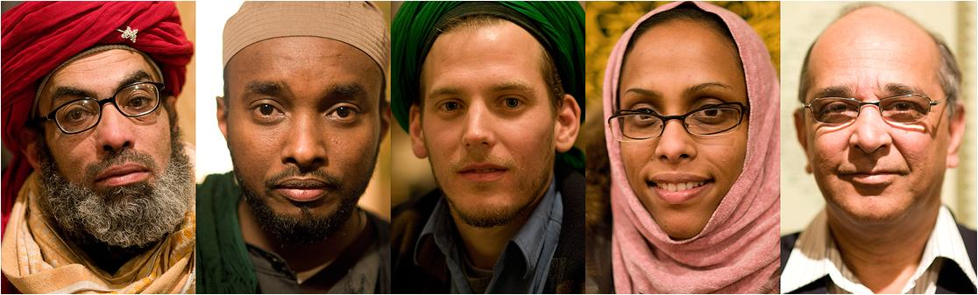
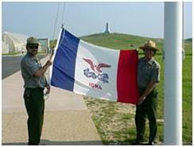
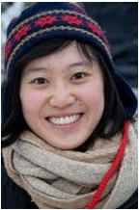

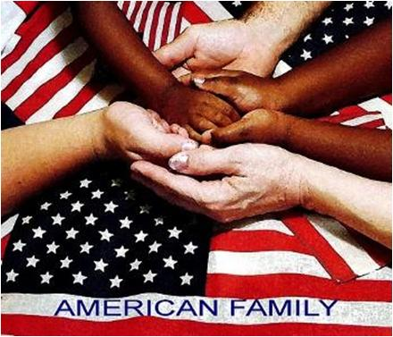
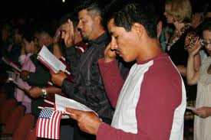

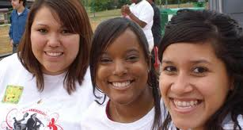
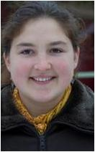

Immigration in Iowa

Slide 91
Foreign Born in Iowa
2013* 149,122
2010* 139,477
2000 91,083
1990 42,029
*American Community Survey, 1 year estimates

Slide 94
Hispanic = Foreign Born
Foreign Born = Hispanic

Slide 98
Driving factors in Iowa immigration:
Food Processing plants

Slide 99
Driving factors in Iowa immigration:
Family reunification

Slide 100
Driving factors in Iowa immigration:
Skilled worker needs
H-1B Visa

Slide 101
Driving factors in Iowa immigration:
Higher Educational Institutions

Slide 102
Driving factors in Iowa immigration:
Refugee admission
Refugee secondary migration

Slide 103
indicators.extension.iastate.edu/publications
June 4th 9:00 AM
Poverty Measures
Webinar
Archived:
Income Measures
Webinar
American Community
Survey Webinar

Slide 104



Thank You
indicators.extension.iastate.edu
Sandra Burke
scburke@iastate.edu
515-294-9307

