Slide 1



Data For You
Income Measures:
What They Are and How To Use Them
Sandra Burke with Liesl Eathington, Cynthia Fletcher, and Bailey Hanson
American Community Survey
Iowa State University Extension and Outreach
Staff Professional Development April 7, 2015

Slide 2
Figure 1. Income
a gain, recurrent benefit, flow of cash/cash equivalents
from work (wages, salary, self-employment)
capital (interest, profit)
land (rents)
assistance transfers (governments or other)
usually measured in monetary terms

Slide 3
Income Measures
income distributions – households and families
median income – households and families
mean (average) – households and families
per capita income of individuals
earnings from wages, salaries, self-employment

Slide 4
Figure 2. Sources of Income Data
American Community Survey (ACS)
    – Census Bureau
Local Area Personal Income Program
    – Bureau of Economic Analysis (BEA)
Small Area Income and Poverty Estimates (SAIPE)
    – Census Bureau

Slide 5
Figure 3. American Community Survey
A large, continuous, monthly, sample survey of housing units (households)
Replaces the decennial census sample portion, “long” form
characteristics of population and housing (not counts)
estimates of characteristics, some uncertainty
Now where we get social, economic, and detailed housing information

Slide 6
Figure 4. American Community Survey – New Things
Period Estimates – 2013 is most recent year of data
  1 year (12 months) 2006 onward to 2013
  3 year (36 months) 2011-2013
  5 year (60 months) 2009-2013
Margins of Error
  smaller or larger

Slide 7
Figure 5. Margins of Error
Because from a sample, uncertainty
Smaller sample has greater uncertainty
Estimate +/- margin of error (90% confidence)
For smaller population areas, need more months/years of sampling to get a *!#reasonably#!* reliable estimate
Always report margins of error

Slide 8
Figure 6. Period Estimates for Iowa
 | 1-year estimates | 3-year estimates | 5-year estimates
65,000+ people | X | X | X
20,000 – 64,999 people |  | X | X
Less than 20,000 people |  |  | X
10 counties
6 cities
26 counties
17 cities
63 counties
all remaining incorporated places

Slide 9
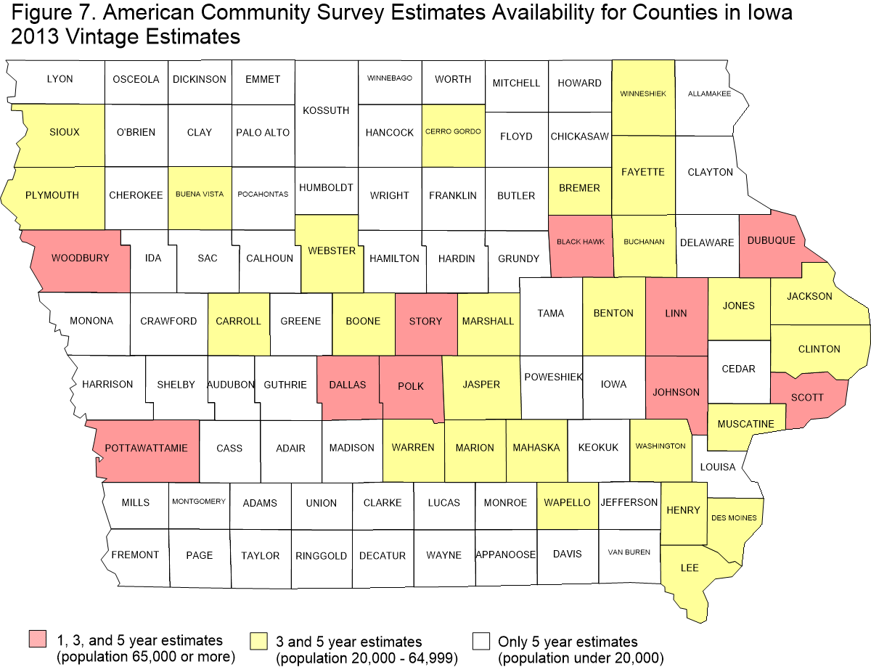

Slide 10
Figure 8. American Community Survey
Income concept is money or cash received by individuals
Does NOT include “in-kind” benefits, imputed income or benefits, or benefits paid to organizations on behalf of individuals
Collects from individuals then adds to get household, family, and aggregate totals
“Bottom-up” approach

Slide 11
Previous 12 months for each type

Slide 12
Figure 9. Households
At least one person in an occupied housing unit
Income includes that of householder plus all other persons 15 years or over, whether related to householder or not
Income totals reported as a distribution across income categories

Slide 13
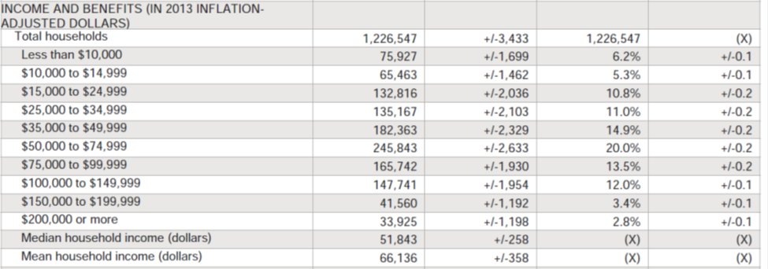
Figure 10. Household Income Distribution

Slide 14
Figure 11. Families
Family Households (subset of households)
Two or more persons in an occupied housing unit who are related to each other
Family income includes that of householder plus all other persons 15 years or over who are related to householder
Income totals reported as a distribution across income categories

Slide 15
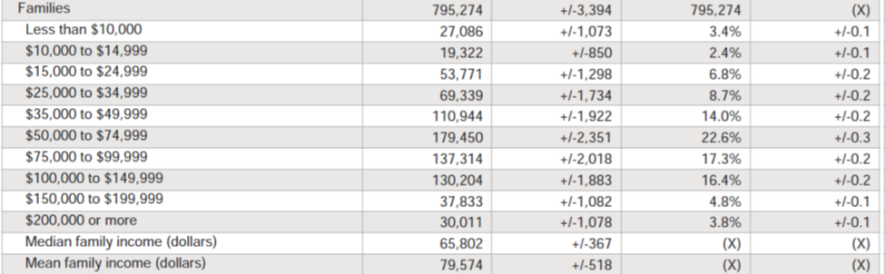
Figure 12. Families Income Distribution

Slide 16
Family households must have at least two persons, thus may have more workers or sources of income
Family income measures are usually higher than the equivalent measures for households
lowest -- 75,927 households 27,086 families (35.7%)
highest -- 33,925 households 30,011 families (88.5%)

Slide 17
Figure 13.

Slide 18
Figure 14.

Slide 19
Figure 15. Median Income
Key indicator of central tendency, used often
Income distribution divided into two equal halves
Median is middle value, half above and half below
Includes those units with no income
Household median - $51,843
Family median - $65,802

Slide 20
Figure 16. Mean (Average) Income
Another indicator of central tendency
Incomes of all households or families summed (aggregate) then divided by number of households or families
Includes those units with no income
Household mean - $66,136
Family mean - $79,574

Slide 21
Figure 17. Mean (Average) Income
Usually higher than median -- $14,000
Sensitive to upward skew by a small number of extremely high incomes in the distribution
Mean is usually further away from the typical income level that most households or families actually experience
Use of medians usually recommended over means

Slide 22
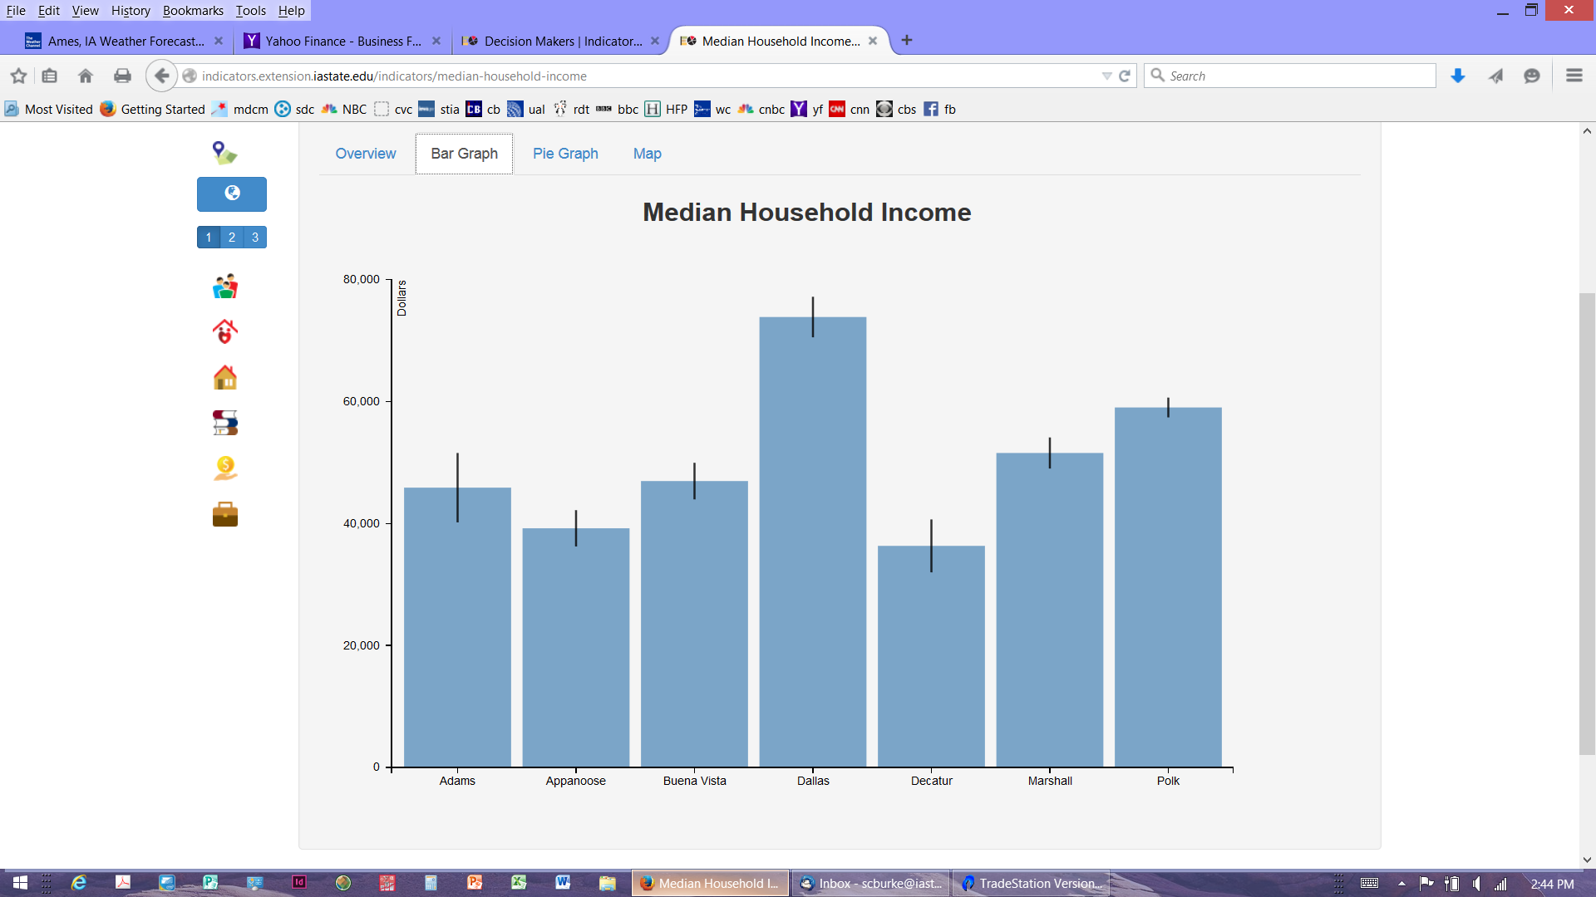

Slide 23
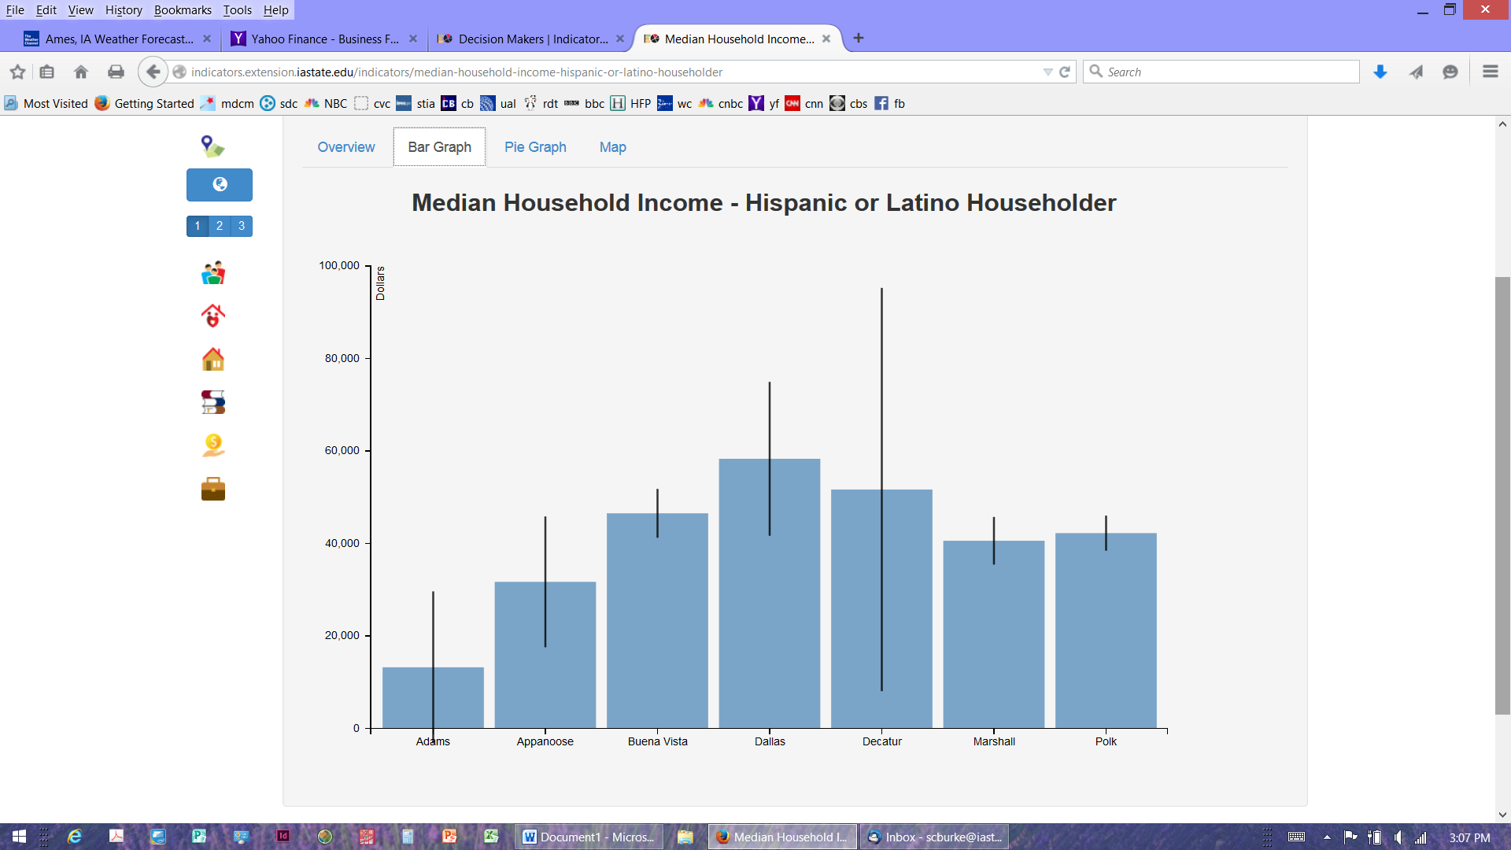

Slide 24
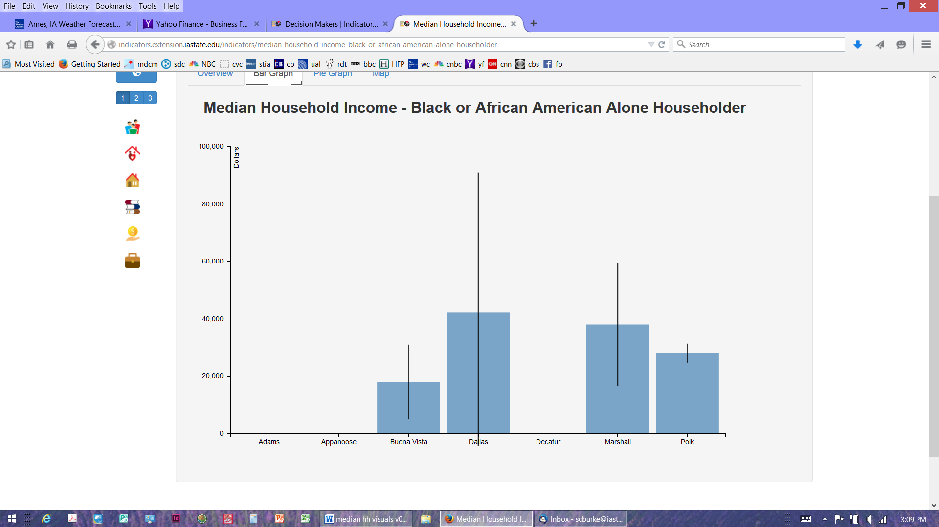

Slide 25
Figure 18. Per Capita Income
Average income of individuals in a geographic region
Starts with total aggregate income of persons 15 years and older in the geographic region
Aggregate income total then divided by the total population of the region, including children, older residents, group quarters population
Aggregate Income / Total Population = Per Capita Income
Iowa per capita $27,027

Slide 26
Figure 19. Earnings
Employment related income from wages, salaries, or net self-employment for persons 16 years and older
Amount received before deductions for taxes, Social Security, etc.
Table by sex
Table for year-round, full-time workers

Slide 27
Figure 20. Earnings
Median for all workers with earnings -- $29,498
Males -- $35,502 Females -- $23,707
Median for year-round, full-time workers with earnings
Males -- $45,814 Females -- $35,025

Slide 28
Figure 21. Data Provided Here
Economic Profile – DP03 Useful summary (pages 19 - 23)
American Community Survey, 5-Year Estimates, 2009 – 2013
Selected items: Tables S1902, S1903, S2001
Iowa and U.S. (pages 26 – 27)
Polk Co, Des Moines (pages 28 – 29)
Adams Co, Corning (pages 30 – 31)
Wapello Co, Ottumwa (pages 32 – 33)
Allamakee Co, Waukon (pages 34 – 35)
Black Hawk Co, Waterloo (pages 36 – 37)
Buena Vista Co, Storm Lake, Alta (pages 38 – 39)
Woodbury Co, Sioux City (pages 40 – 41)

Slide 29
Figure 22. Answer Some Questions (pages 26 – 27)
Which has highest median household income? Iowa or US?
Margin of error for Iowa median household income?
Margin of error for US median household income?
How does Iowa Black/African American median compare to White?
Margin of error for Iowa Native Hawaiian median?
Is Iowa median for Hispanics higher or lower than for Blacks?

Slide 30
Figure 23. Answer More Questions (pages 26 – 27)
What age group in Iowa has highest median household income?
Median income female householders, no husband present Iowa?
Median earnings for males and females, which higher?
Does education level tend to increase earnings?

Slide 31
Figure 24. Choose a county and town pair
Polk Co, Des Moines (pages 28 – 29)
Adams Co, Corning (pages 30 – 31)
Wapello Co, Ottumwa (pages 32 – 33)
Allamakee Co, Waukon (pages 34 – 35)
Black Hawk Co, Waterloo (pages 36 – 37)
Buena Vista Co, Storm Lake, Alta (pages 38 – 39)
Woodbury Co, Sioux City (pages 40 – 41)

Slide 32
Figure 25. More Questions (pages 28 – 35)
Is Polk County’s median household income higher or lower than the city of Des Moines?
For Corning, what race groups have median household income data? For Adams County?
For Ottumwa, what proportion of households are Hispanic?
Is the median household income of Hispanics higher or lower than that of Whites?
For Allamakee County, how does the median earnings of female high school graduates compare with the median earnings of male high school graduates?

Slide 33
Figure 26. More Questions (pages 36 – 41)
For Waterloo, what proportion of households are Black or African American? How does the margin of error for median household income for American Indians or Alaska Natives compare with the actual median estimate? How about for Black Hawk County?
For Storm Lake, what proportion of households are Hispanic?
What proportion of households are Asian?
How does median household income of Hispanics compare to Whites? How does per capita income of Hispanics compare to Whites?
For Woodbury County, how does the median earnings for females with a graduate or professional degree compare with males?

Slide 36
Figure 27. Inflation Adjustment
Inflation of prices over time
Data in $$ not comparable in purchasing power across time
ACS collects $$ data across time – 5 years
Adjust $$ values from all years pooled to $$ of last year of set
Monthly Consumer Price Index (CPI) from Dept. Labor
$$ estimates 2009 – 2013 all in 2013 $$ values

Slide 37
Figure 28.

Slide 38
Figure 29.

Slide 39
Figure 30.

Slide 40
Figure 31. Bureau of Economic Analysis (BEA)
Income concept is “personal” income
INCLUDES “in-kind” benefits, imputed income or benefits, or benefits paid to organizations on behalf of individuals
Collects from administrative records of business and governmental sources NOT from people
A “top-down” approach

Slide 41
Figure 32. Bureau of Economic Analysis (BEA)
Money and support paid out by entities, governments, businesses, organizations
Based on what records say was “paid out” to a region
Pay given by businesses by place of work is reallocated to place of residence

Slide 42
Figure 33. Bureau of Economic Analysis (BEA)
Sums up all income and support payments recorded as distributed to people and support entities in a region
The sum is the Aggregate Personal Income
Aggregate Personal Income / Total Population = Per Capita Income
No margins of error because not from a sampling procedure
Annually and no period of years pooling
Counties, States, Regions, U.S.

Slide 43
Figure 34. Bureau of Economic Analysis (BEA)
Aggregate Personal Income / Total Population = Per Capita Income
BEA PCI 2013 $44,763 Iowa
ACS PCI 2013 $27,027 Iowa 5 year estimates
ACS PCI 2013 $26,992 Iowa 3 year estimates
ACS PCI 2013 $27,740 Iowa 1 year estimates

Slide 44
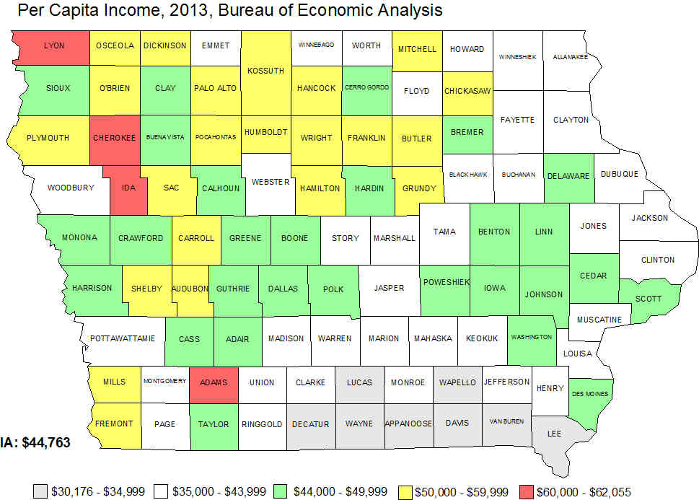
Figure 35.

Slide 45
Figure 36. Bureau of Economic Analysis (BEA)
BEA counts many more kinds of income, imputed income, benefits, “in-kind,” and support from many programs than does the ACS
BEA does not account for who may actually have access to that income, does not do household or family distributions
Think about numerator and denominator. As the denominator becomes smaller as the population estimate declines, the resulting per capita income may become larger based more on the denominator decline rather than a significant increase in the numerator income amount.

Slide 47
Figure 38. Small Area Income and Poverty Estimates (SAIPE) Program
median household income
people and children in poverty
Model based estimates produced by Census Bureau
Model includes information from ACS survey, IRS tax filings, BEA personal income estimation, Decennial Census 2010, SNAP (food stamp) benefits, Decennial Census 2000

Slide 48
Figure 39. Small Area Income and Poverty Estimates (SAIPE)
Annual estimates median household income
Single year estimates all counties, not pooled years
Margins of error ---- Confidence intervals may be asymmetric
SAIPE Median 2013 $52,286 (+/- 522)
ACS Median 2013 $51,843 (+/- 258) 5 year estimates
ACS Median 2013 $51,653 (+/- 274) 3 year estimates
ACS Median 2013 $52,229 (+/- 533) 1 year estimates

Slide 49
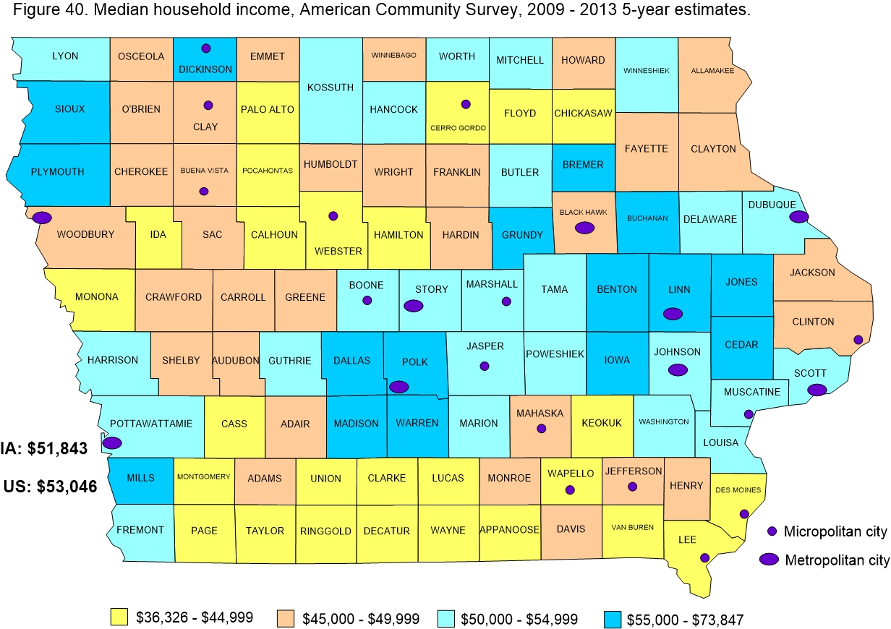

Slide 50
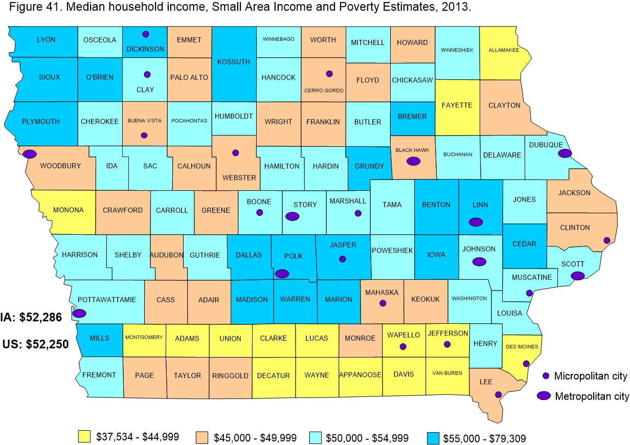

Slide 51

Thank you
Portal Project Web Page: indicators.extension.iastate.edu
Sandra Burke
scburke@iastate.edu
515-294-9307
Liesl Eathington
leathing@iastate.edu
www.icip.iastate.edu
Cynthia Fletcher
cynthia@iastate.edu
Bailey Hanson
bahanson@iastate.edu

