Slide 1
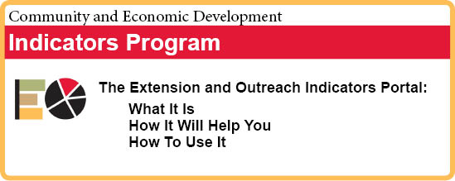
Sandra Burke, Bailey Hanson, Christopher Seeger, and Biswa Das
Iowa State University Extension and Outreach
Staff Professional Development October 20, 2015

Slide 2
What you can find on the Indicators Portal
Data on many Topic and Subject Areas
Tools for Designing Graphs and Maps
Data for Decision Makers County and Region Profiles
Access to City Government Finance Data (IGFI)
Reports on Data Trends and Topics of Interest
Educational Materials on Data Measures and their Use

Slide 3
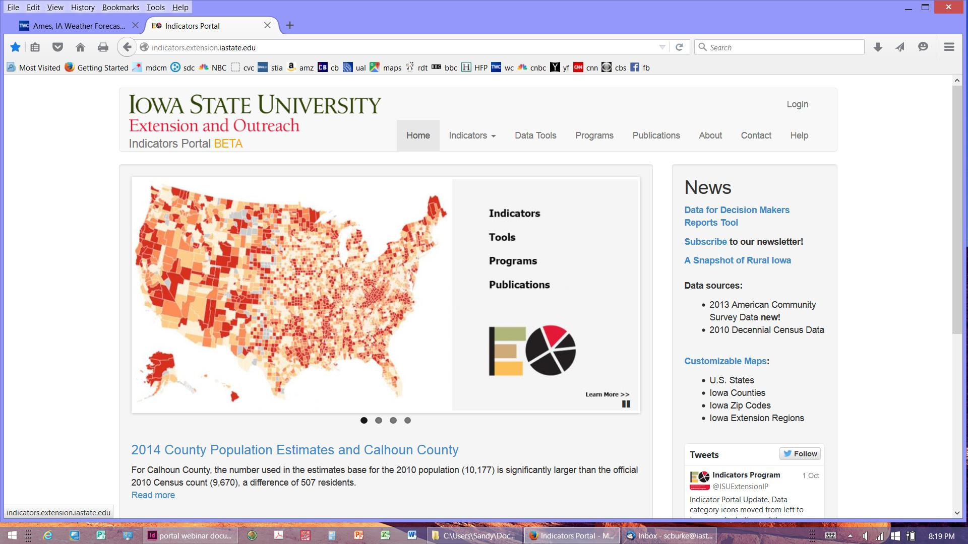
Step 1.*
http://indicators.extension.iastate.edu
*Works best with Google Chrome or Mozilla Firefox

Slide 4
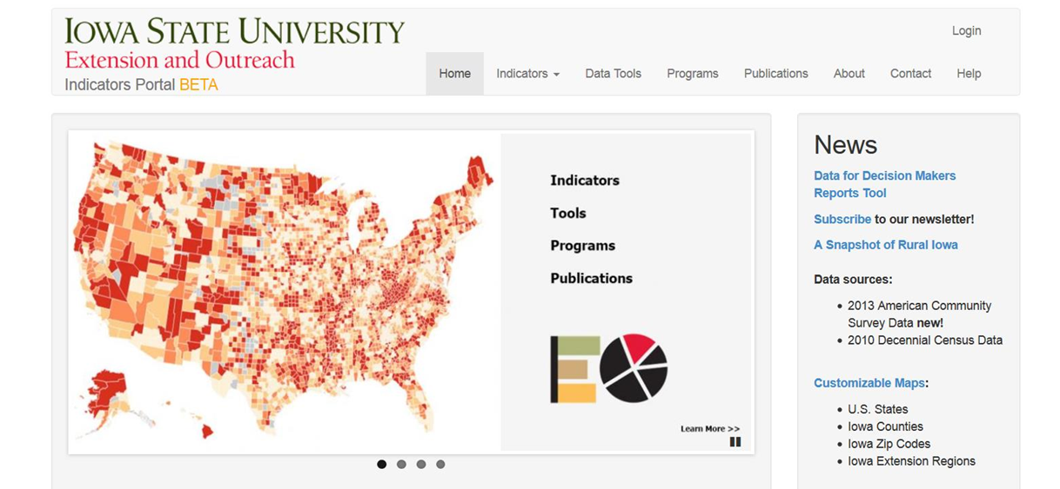
Step 2: Login ISU Net-ID or guest account

Slide 5
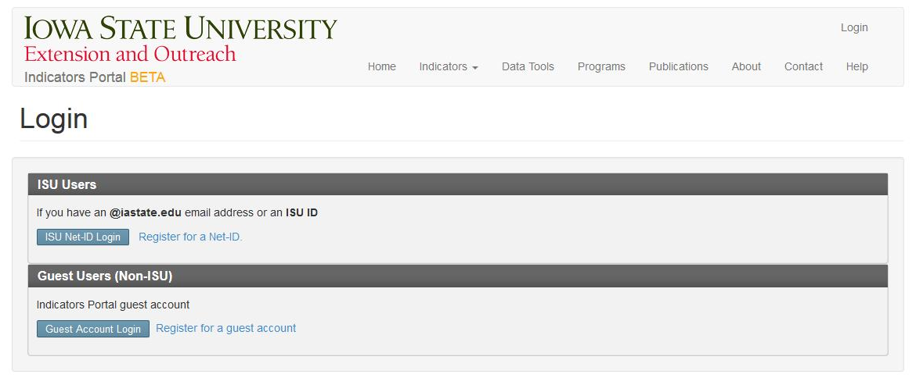
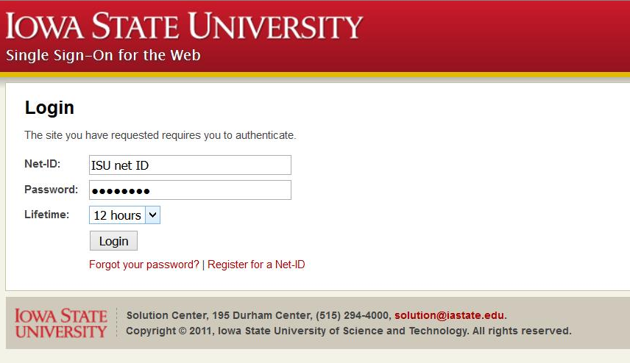
Login Screens

Slide 6
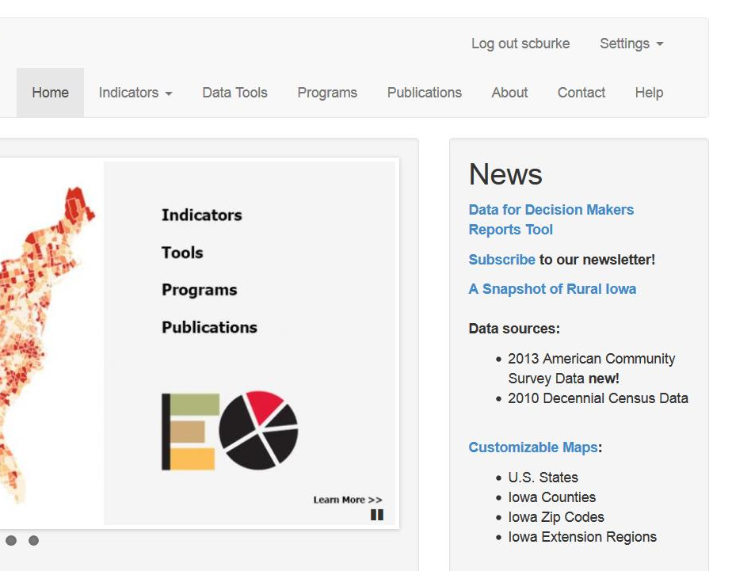
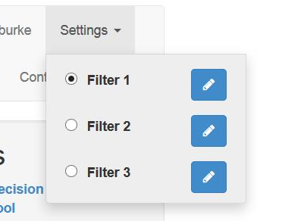
Step 3: Choose Geography Settings

Slide 7
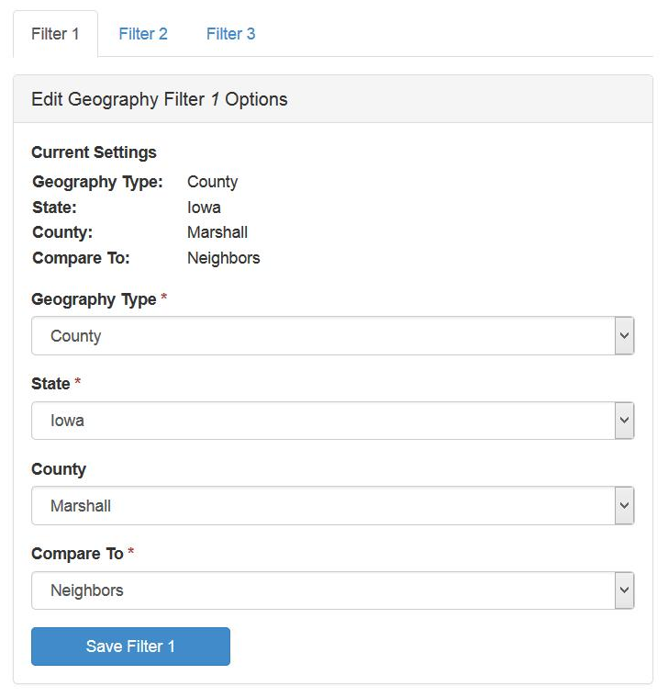
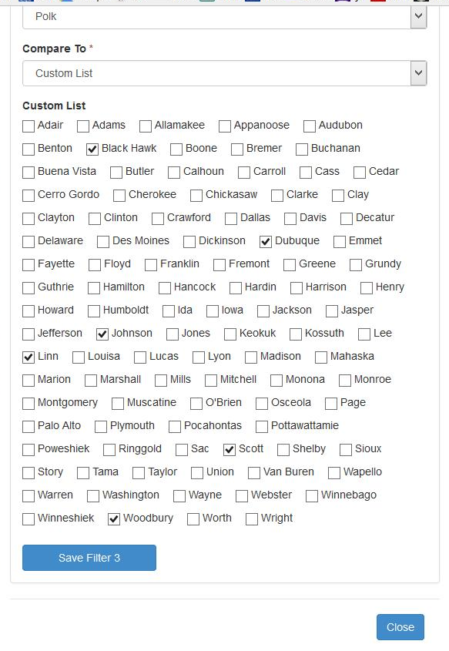
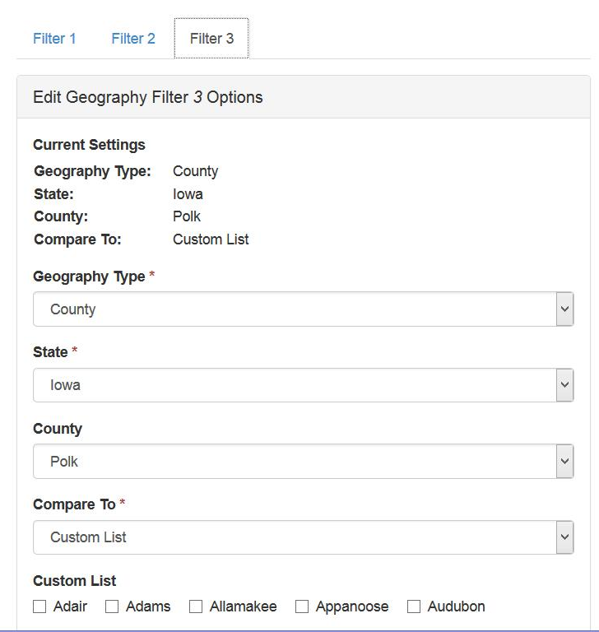

Slide 8
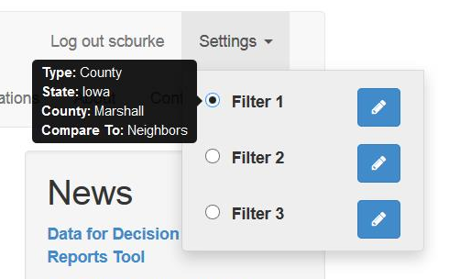
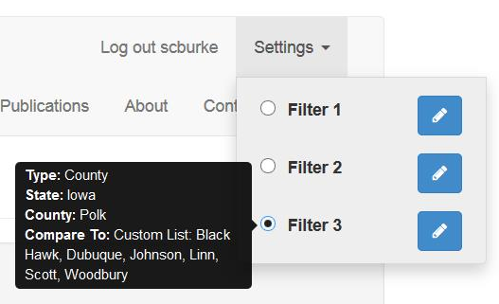
Hover pointer over “Filter” to see geography settings

Slide 9
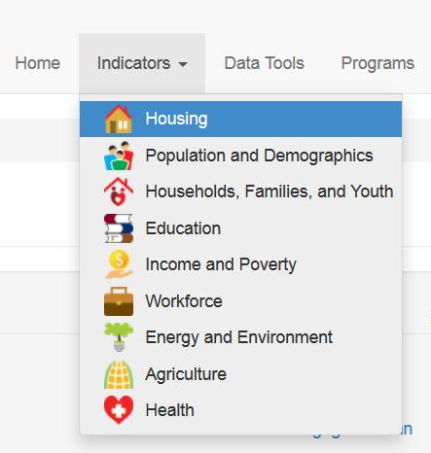
Step 4: Choose Indicators

Slide 10
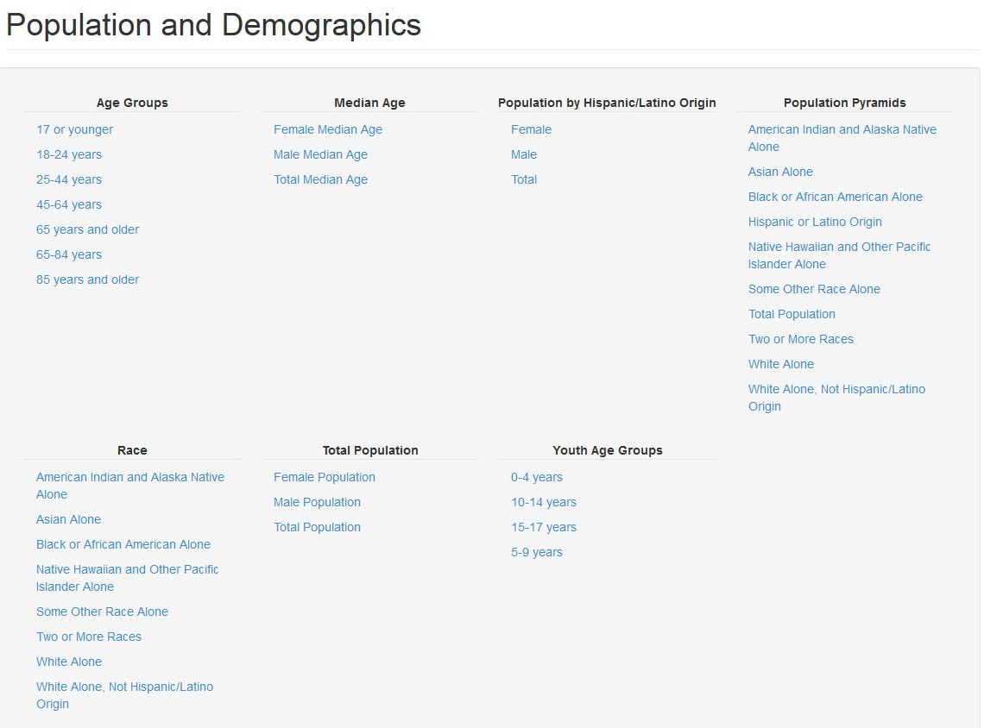

Slide 11
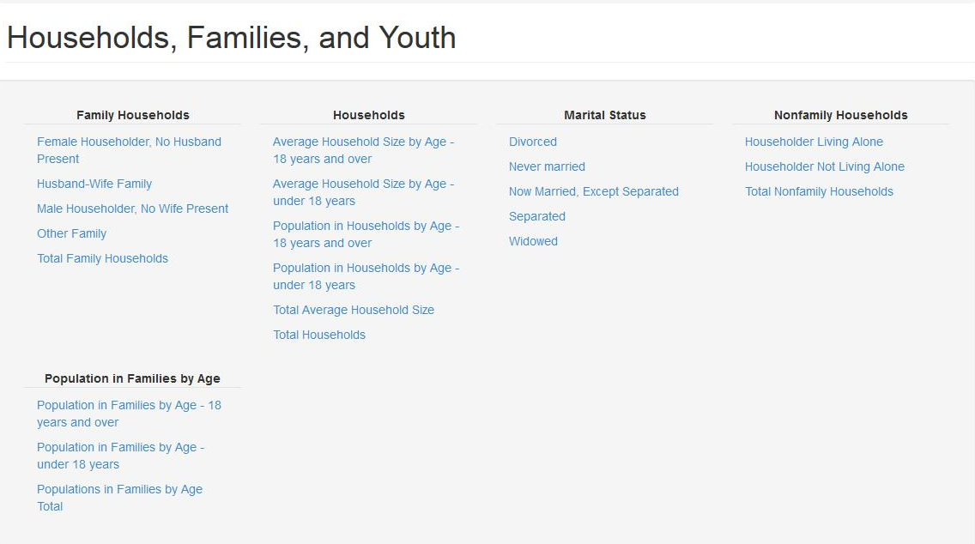

Slide 12
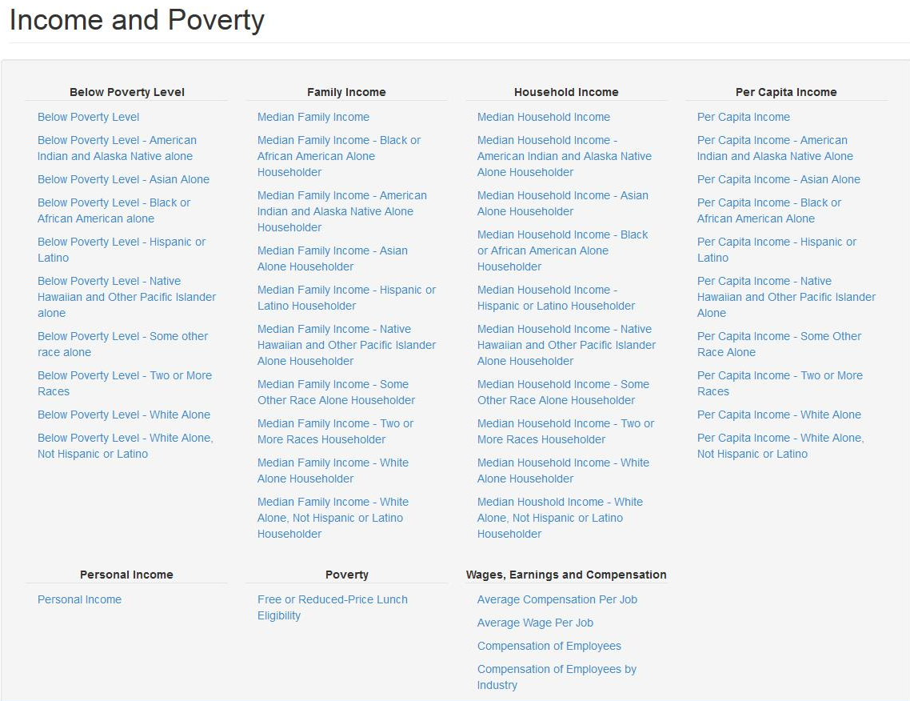

Slide 13
Other Indicators
Educational Attainment
School Enrollments
Employment, Unemployment
Means of Transportation to Work
Housing Units, Owner, Renter
Housing Value, Rent

Slide 14
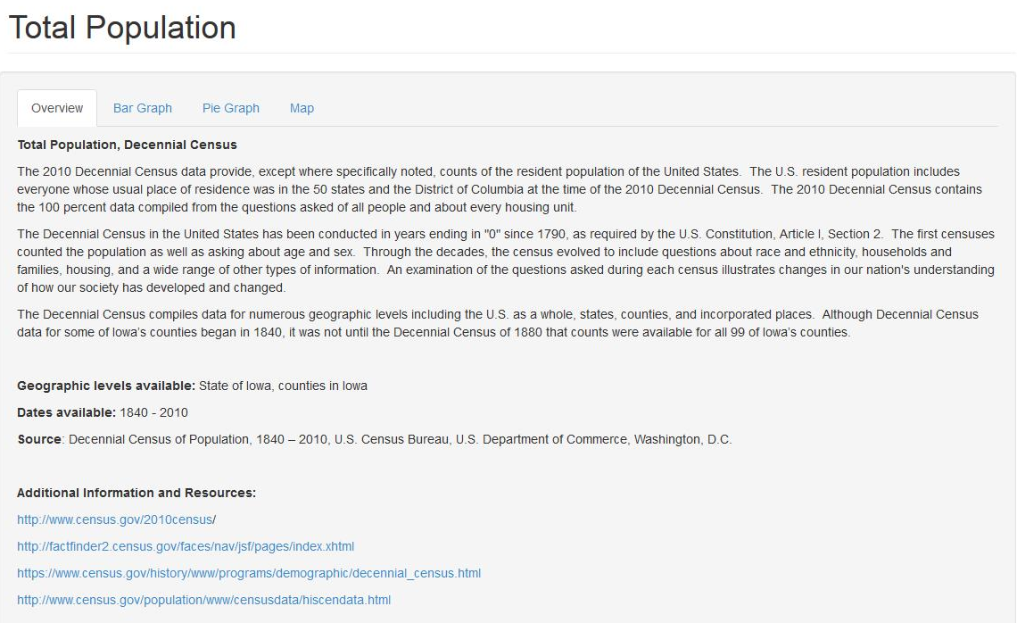

Slide 15
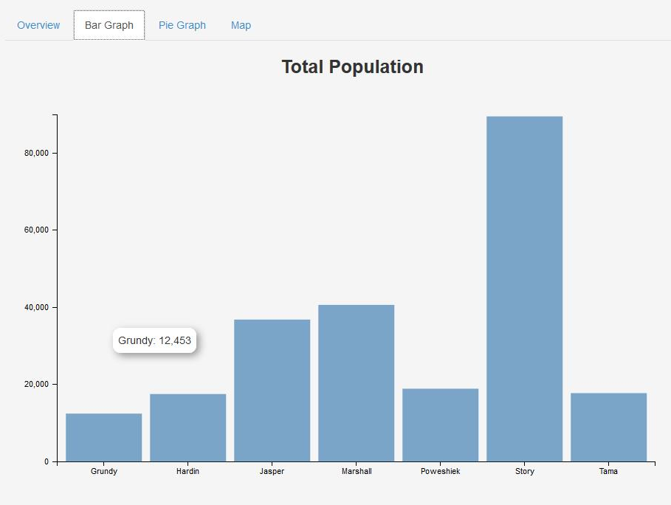
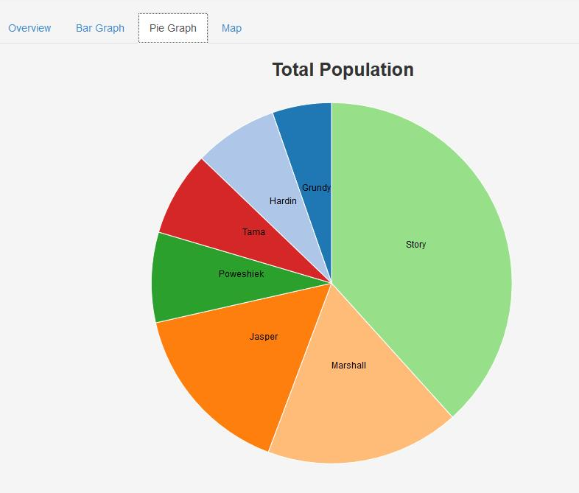
Bar and Pie Graph Examples – Marshall County and Neighbors

Slide 16
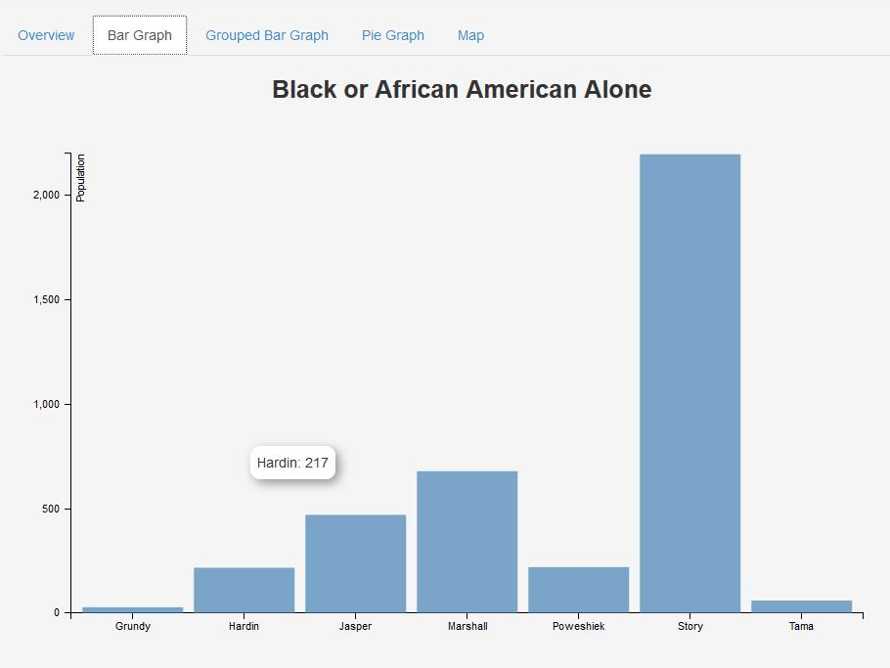
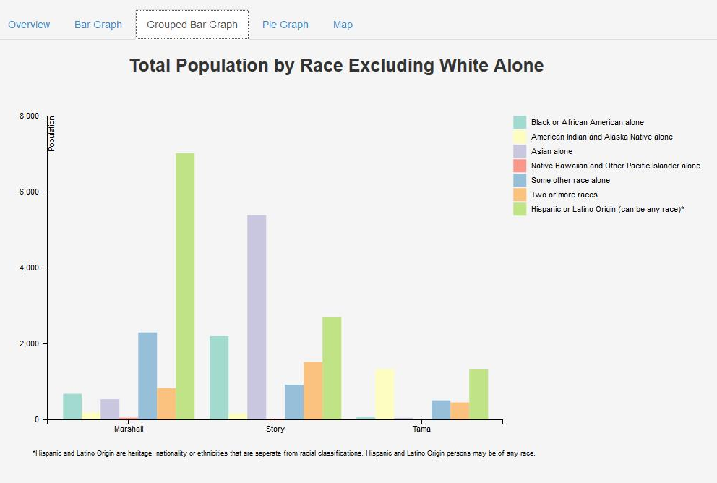
Bar and Grouped Bar Graph Examples – Race and Minorities*
*Hispanic or Latino Origin is an ethnic group and can be of any race

Slide 17
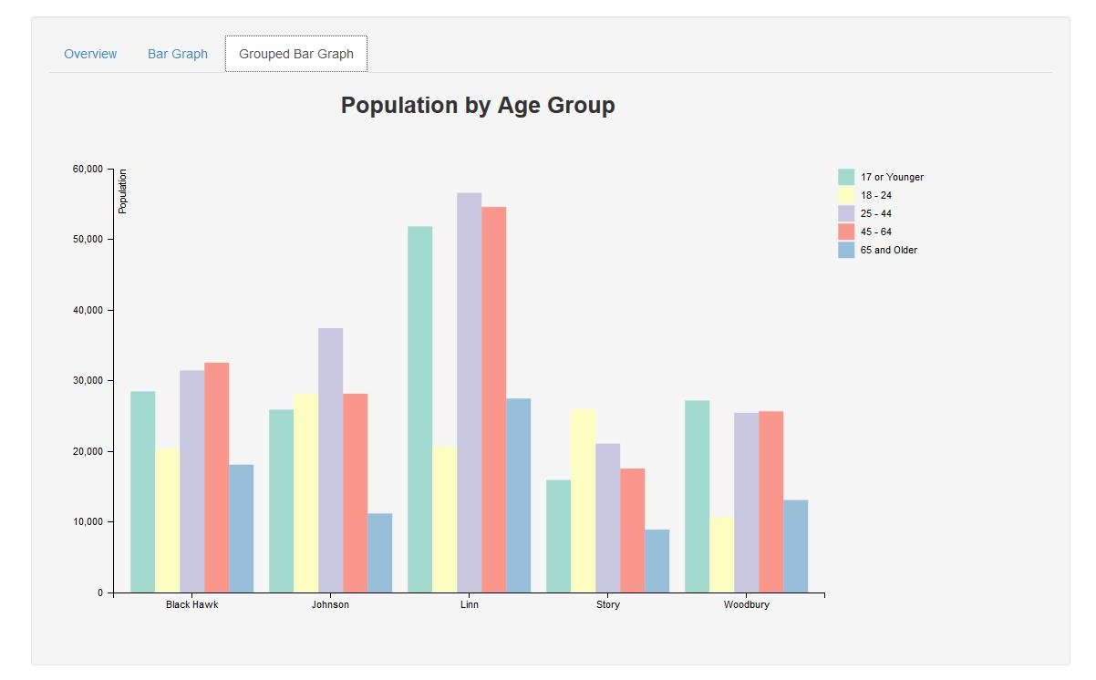
Grouped Bar Graph Example – Age Groups

Slide 18
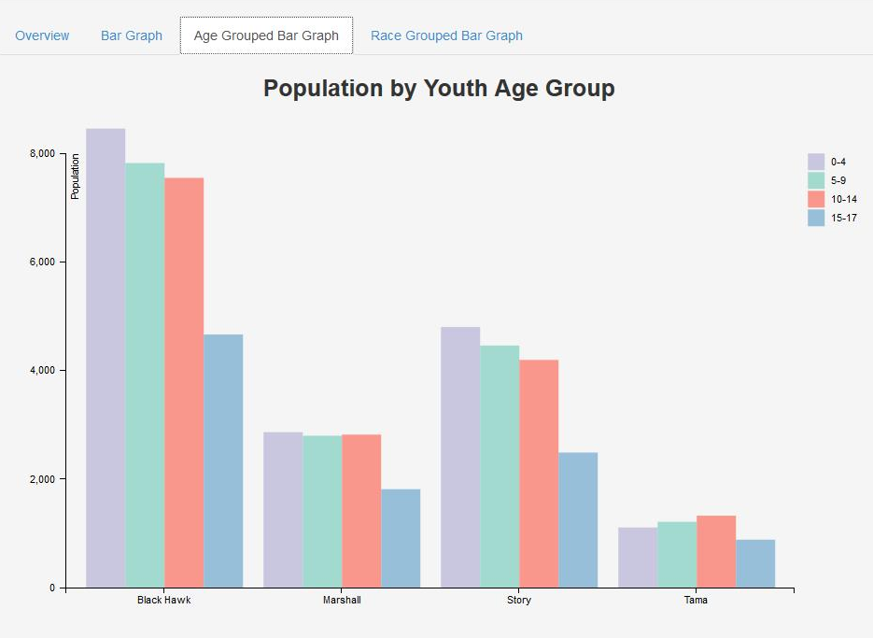
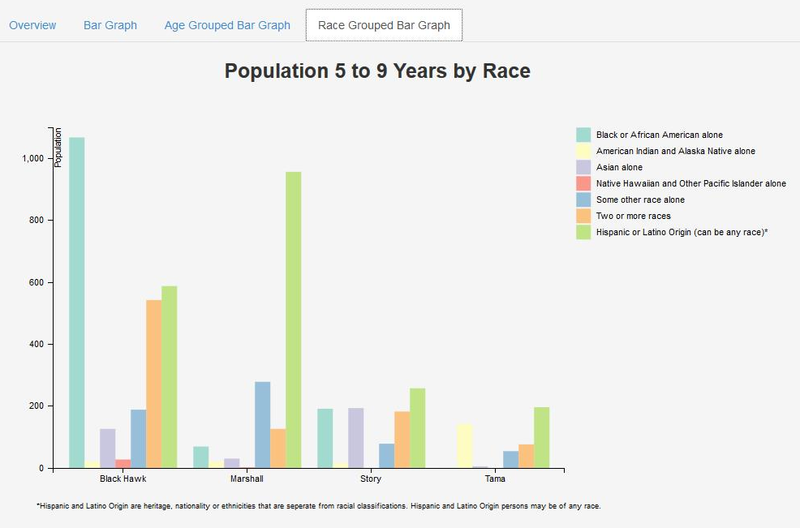
Youth Age Group Graph Examples – Total and Minorities*
*Hispanic or Latino Origin is an ethnic group and can be of any race

Slide 19
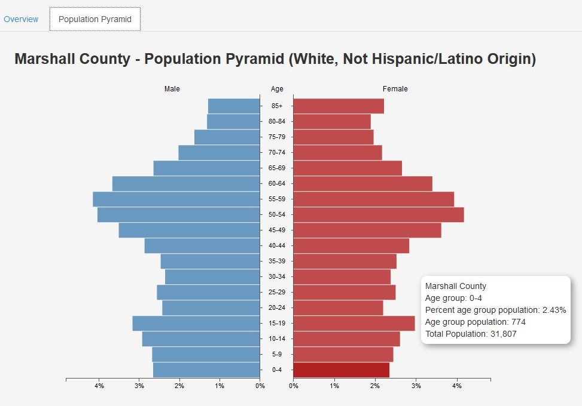
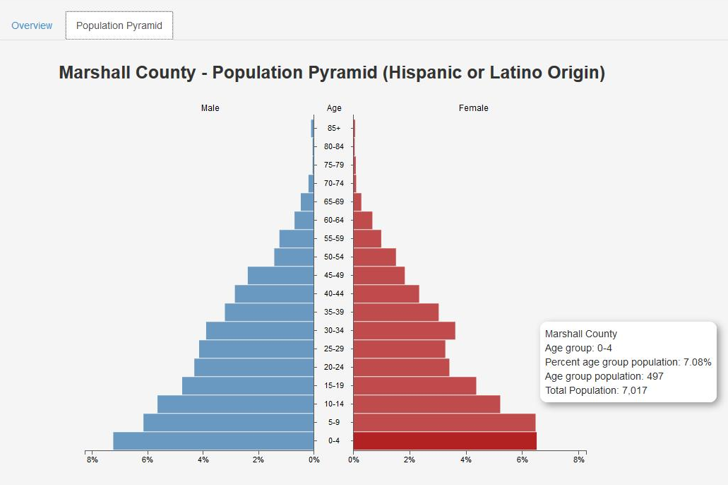
Population Pyramid Examples – White, Not Hispanic and Hispanic

Slide 20
American Community Survey (ACS)
Comprehensive set of socioeconomic characteristics
A large, continuous, monthly, sample survey of housing units (households)
Replaces the decennial census sample portion, “long” form
characteristics of population and housing (not counts)
estimates of characteristics, some uncertainty
Now where we get social, economic, and detailed housing information

Slide 21
American Community Survey – New Things
Period Estimates – 2013 is most recent year of data
  1 year (pooled 12 months) 2006 onward to 2013
  5 year ( pooled 60 months) 2009-2013
Margins of Error (MOE)
Because from a sample, uncertainty
  smaller or larger
  Estimate +/- margin of error (90% confidence interval)
  Always report margins of error

Slide 22
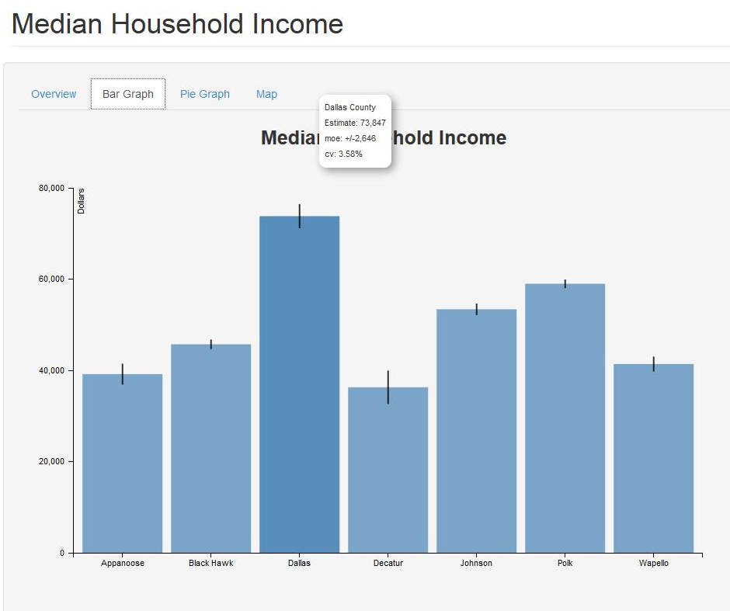

Slide 23
Evaluate Margins of Error
When are they too big to use??
Relative size of the error to the size of the estimate
A few can just “eyeball,” they look bad, are really large
Correct method – calculate Coefficient of Variation (CV)
The Indicators Portal calculates CVs!!!

Slide 24
Coefficient of Variation (CV):
Relative amount of sampling error associated with a sample estimate
CV = (Standard Error/Estimate) * 100%
      or
CV = ((MOE/1.645) / Estimate) * 100%
high reliability = CV <= 12% - 15%
medium reliability = CV 15% - 30%
low reliability = CV > 30% - 40% Think about not using

Slide 25
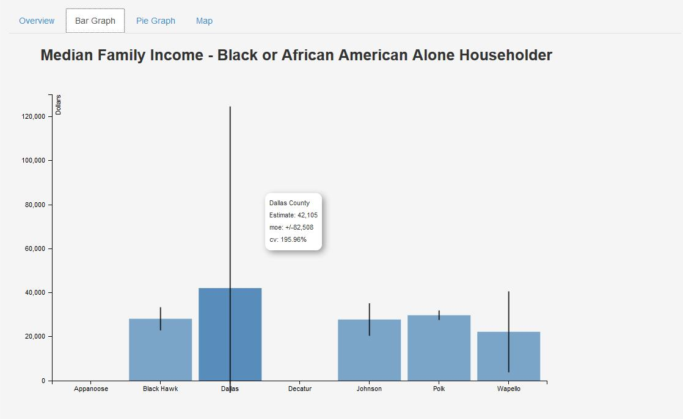
Cautions for small subgroup populations!!!

Slide 26
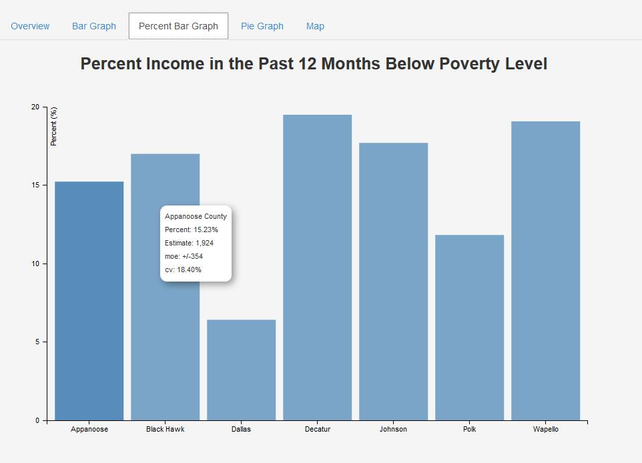

Slide 27
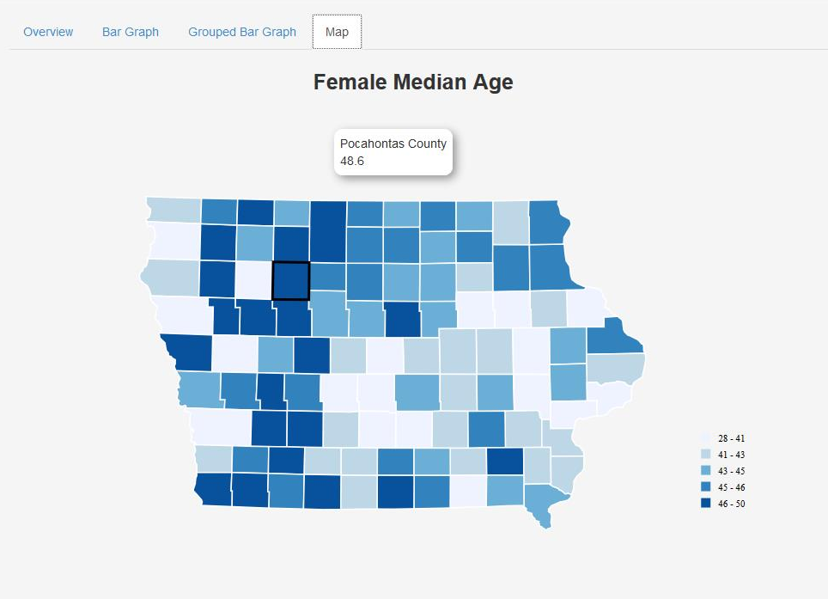
Map Example – Female Median Age

Slide 28
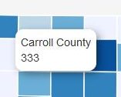
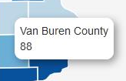




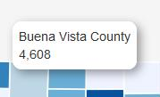
County-to-County Comparisons with pop-ups – Hispanic Population

Slide 29
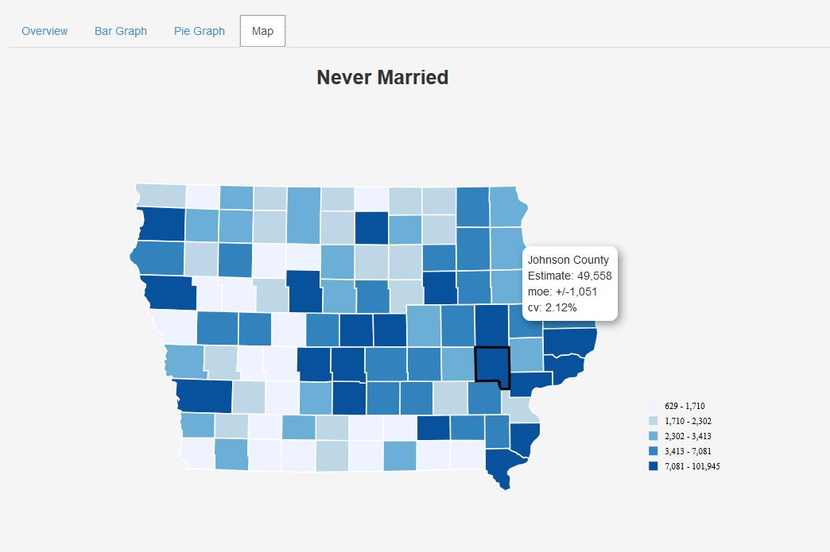
Map Example – Marital Status, Never Married

Slide 30
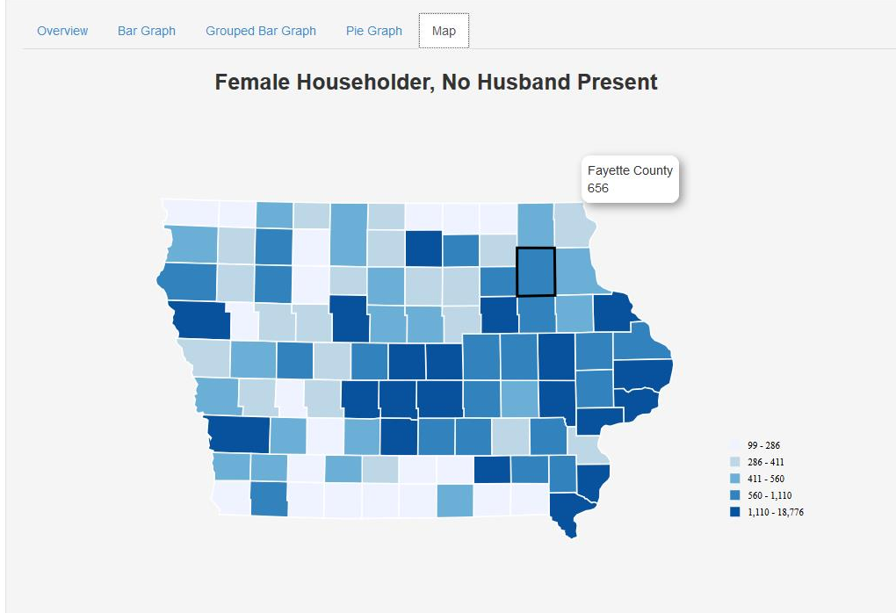
Map Example – Household Type
Female Householder, No Husband Present

Slide 31
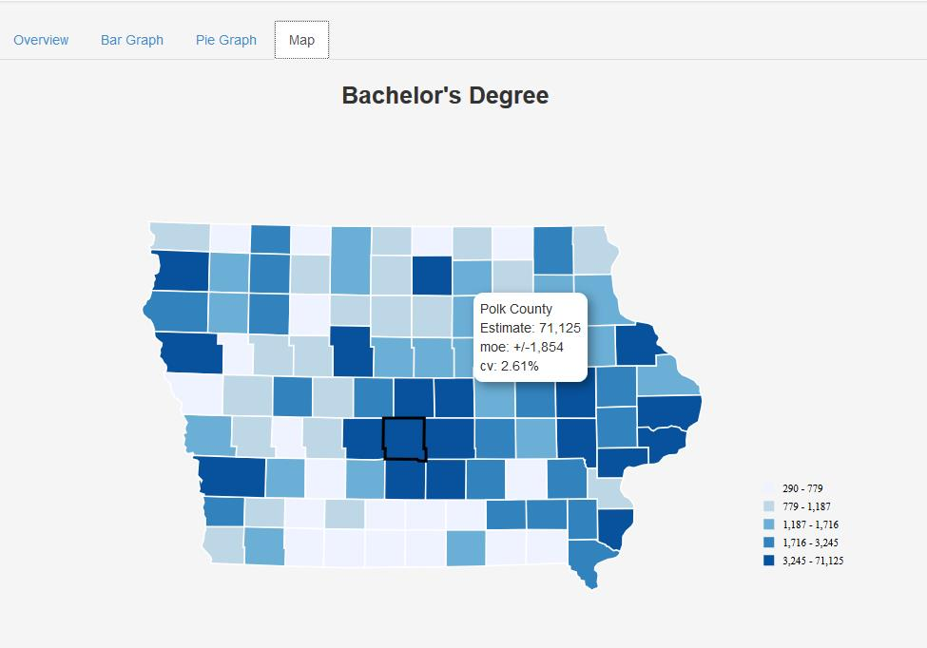
Map Example – Educational Attainment Bachelor’s Degree

Slide 32
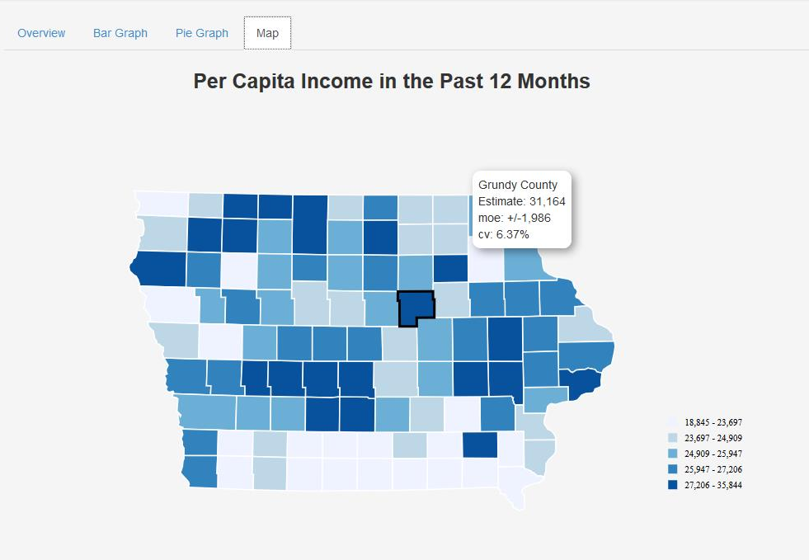
Map Example – Per Capita Income

Slide 33
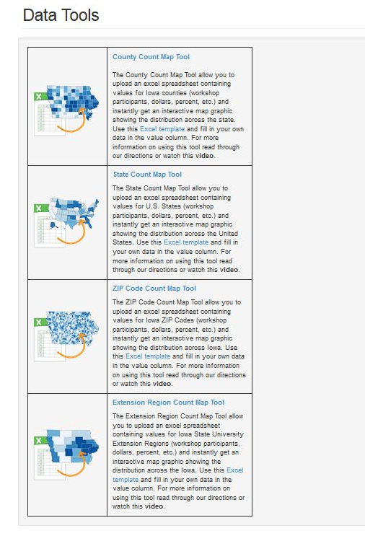
Data Tools – Custom Maps

Slide 34
Data for Decision Makers

Slide 35
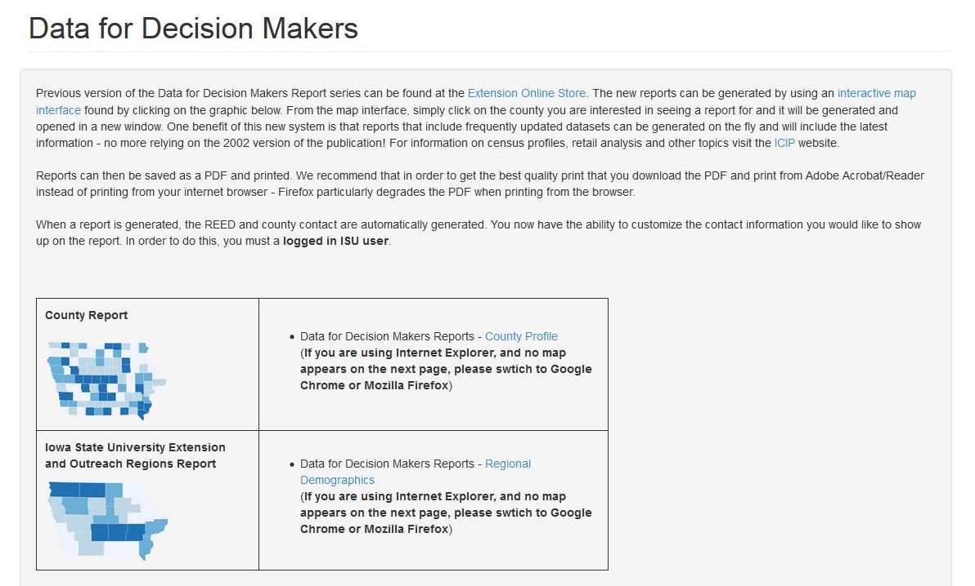
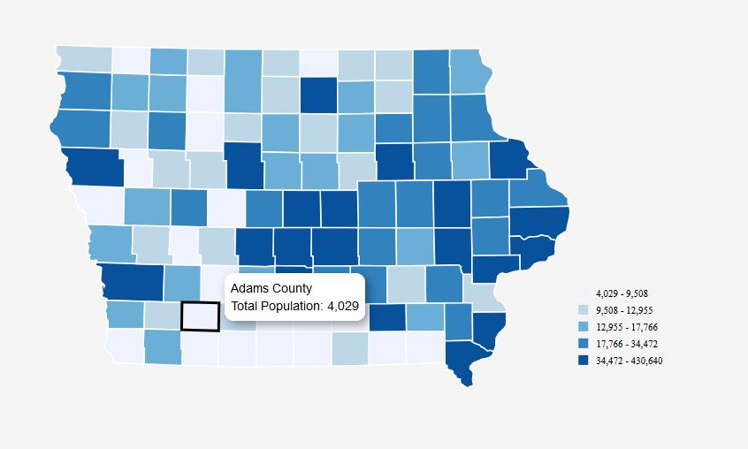
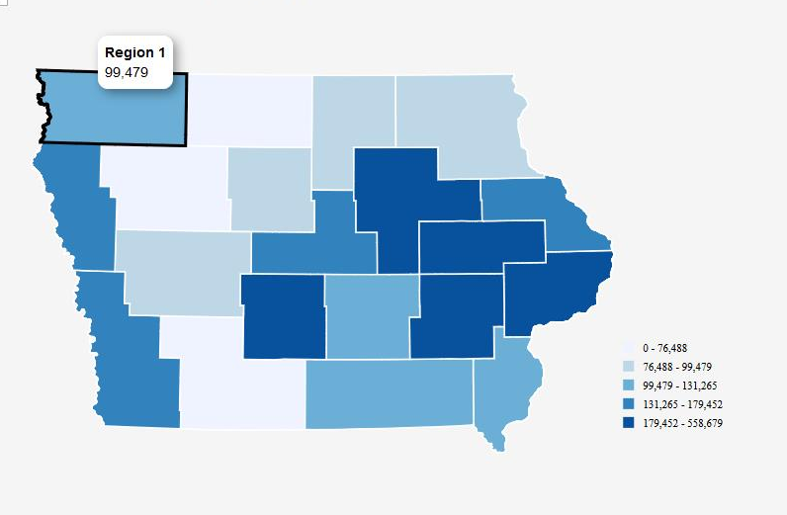

Slide 36
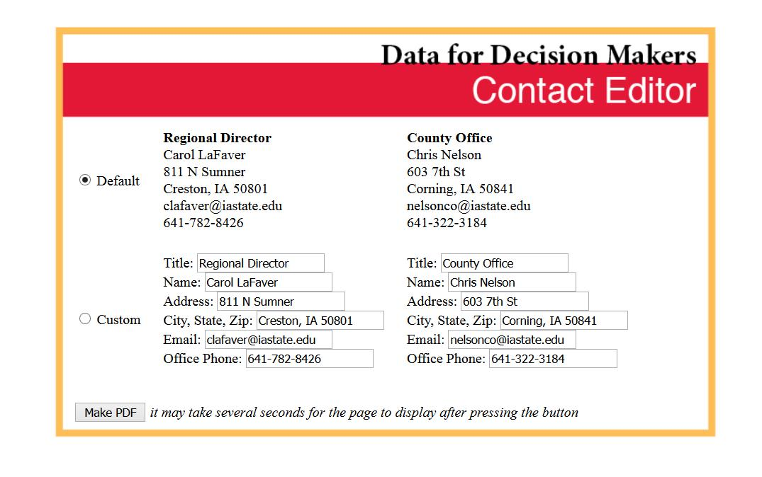
ONLY ISU logged in staff will see this contact editor screen!

Slide 37
County Profile
Page 1

Slide 38
County Profile
Page 2

Slide 39
County Profile
Page 3

Slide 40
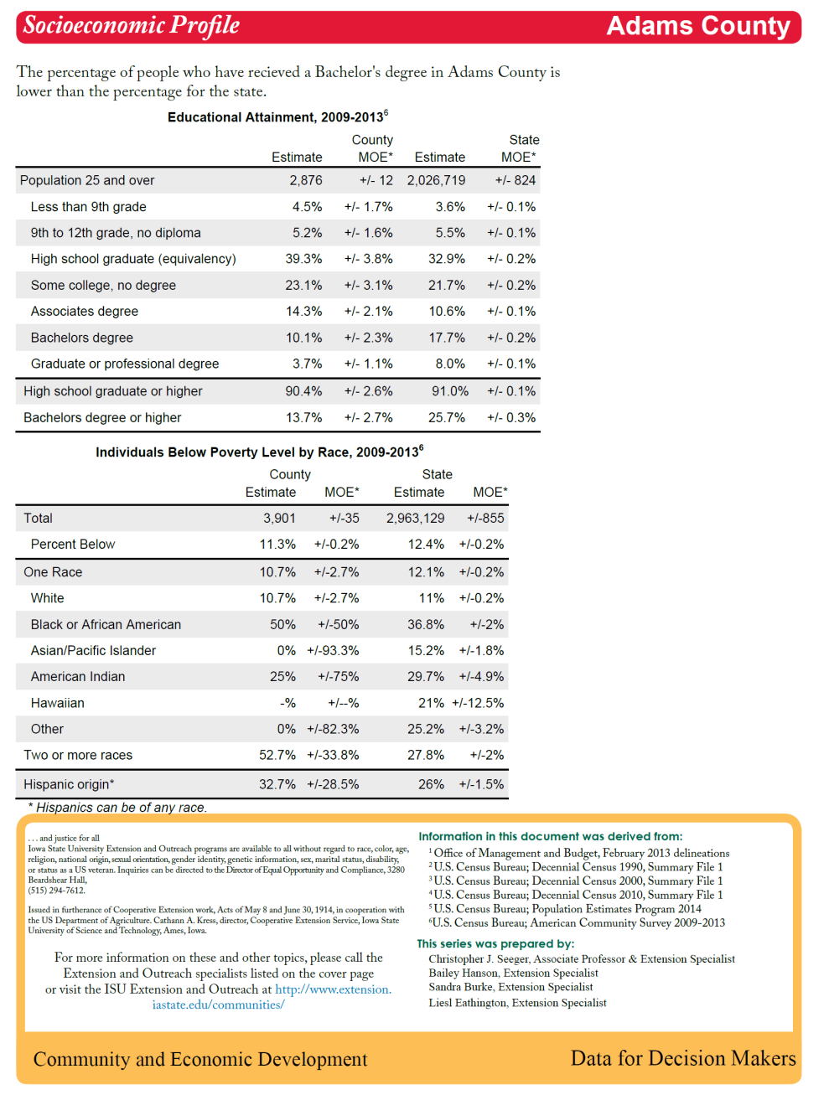
County Profile
Page 4

Slide 41
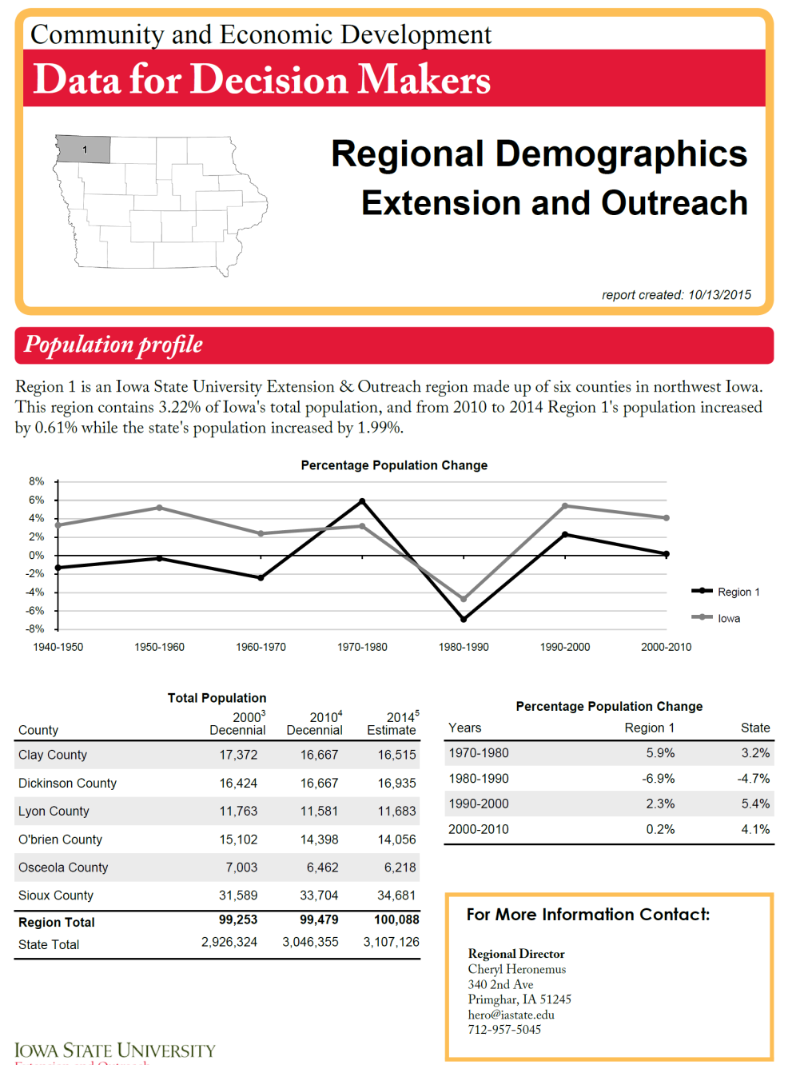
Extension Region Profile Page 1

Slide 42
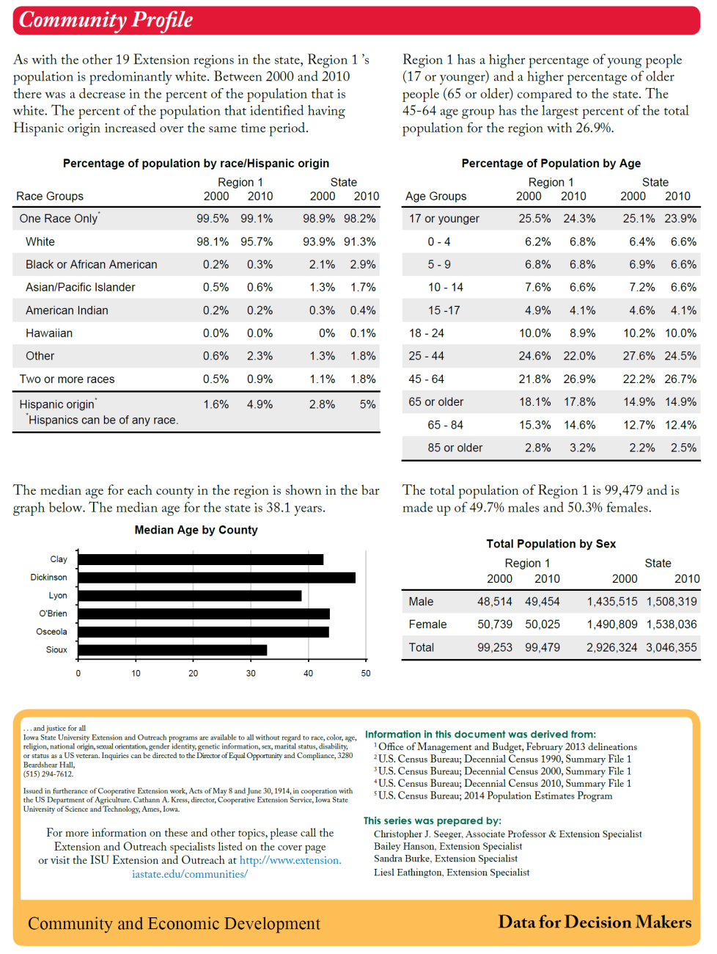
Extension Region Profile Page 2

Slide 43
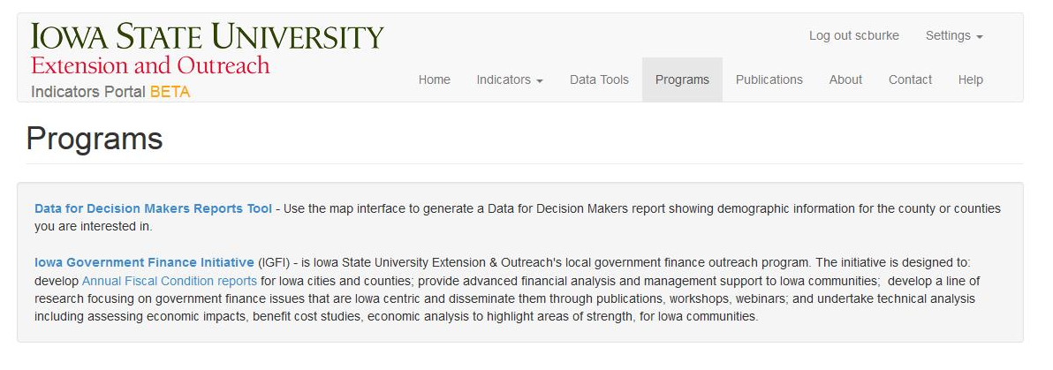
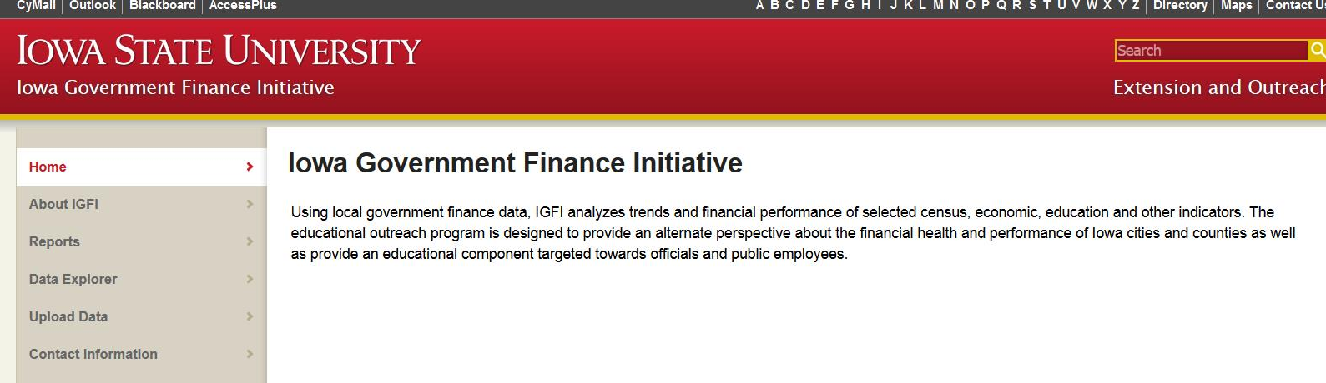
Iowa Government Finance Initiative
http://igfi.extension.iastate.edu
Biswa Das
Cindy Kendall

Slide 44
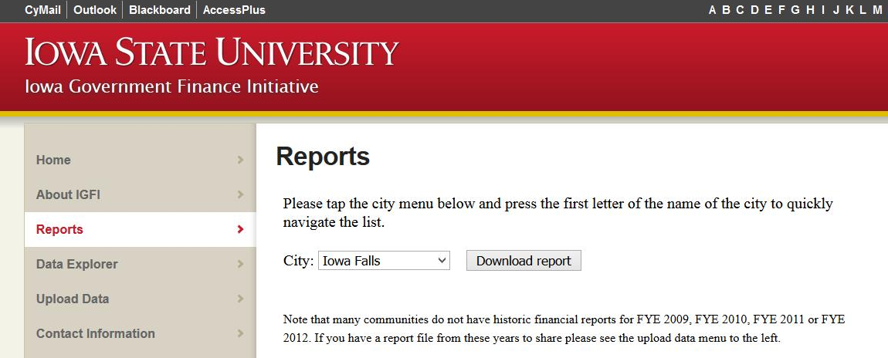
Each report has these sections:
• Legislative Updates
• Indicators
––Socioeconomic Conditions
––Revenue
––Expenditures
• Implications and Discussion

Slide 48
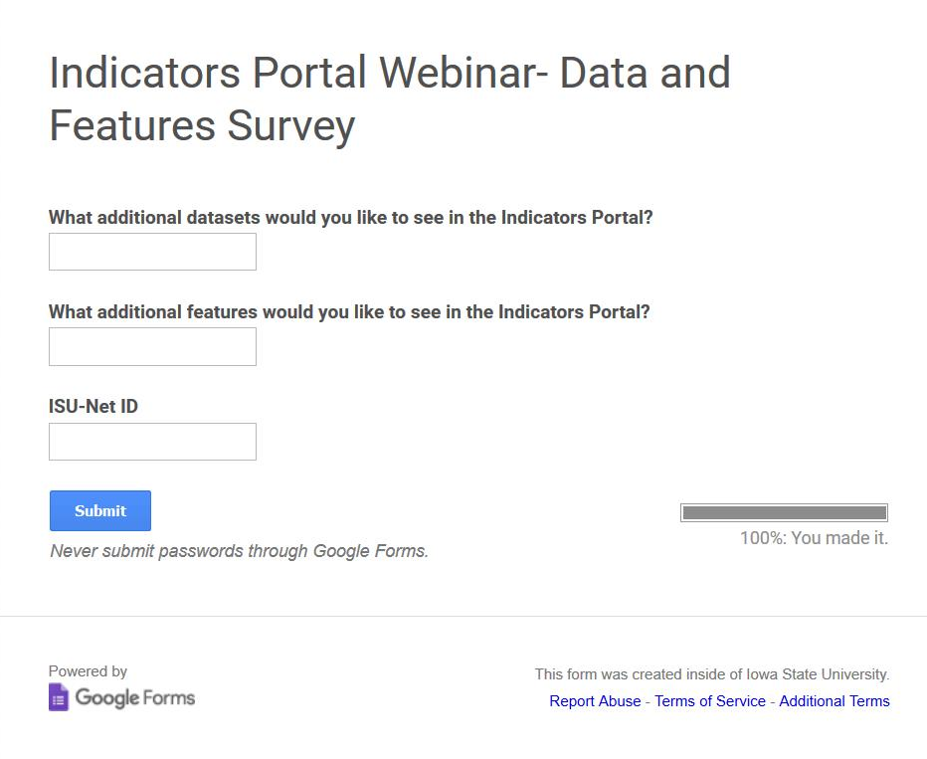
http://goo.gl/forms/xaDYTxIzQB

Slide 49

Thank you
Indicators Portal Page: indicators.extension.iastate.edu
Information email: indicators@iastate.edu
Tweet to: @ISUExtensionIP
http://goo.gl/forms/xaDYTxIzQB
Christopher J. Seeger
cjseeger@iastate.edu
515-509-0651
Bailey Hanson
bahanson@iastate.edu
515-520-1436
Biswa Das
bdas@iastate.edu
515-509-9603
Sandra Burke
scburke@iastate.edu
515-294-9307

